Slide 1
TypeScript

Slide 2
TypeScript
Programming language
Free and Open Source Project
Developed and maintained by Microsoft
Notes:
https://www.icontemp.com/typ/
Course:
https://www.tutorialspoint.com/typescript/
https://learnxinyminutes.com/docs/typescript/ !!!!

Slide 3
Why TypeScript
Problem with Javascript:
Example:
Functions parameters
Cannot enforce structure of objects
Complexity of application we are building today with JS
Notes:
https://www.icontemp.com/typ/
Course:
https://www.tutorialspoint.com/typescript/
https://learnxinyminutes.com/docs/typescript/ !!!!

Slide 4
Why still javascript?
Notes:
https://www.icontemp.com/typ/
Course:
https://www.tutorialspoint.com/typescript/
https://learnxinyminutes.com/docs/typescript/ !!!!

Slide 5
What to do so?

Slide 6
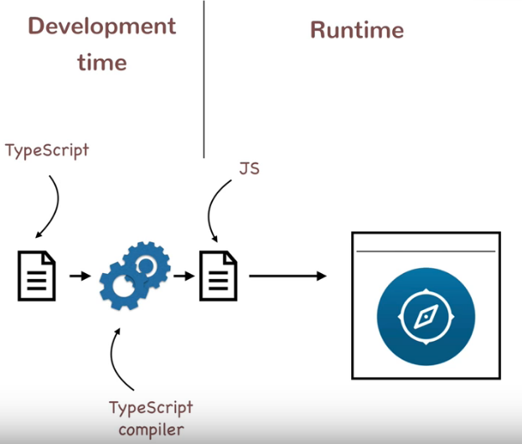
TS came on board

Slide 7
and Node JS…

Slide 8
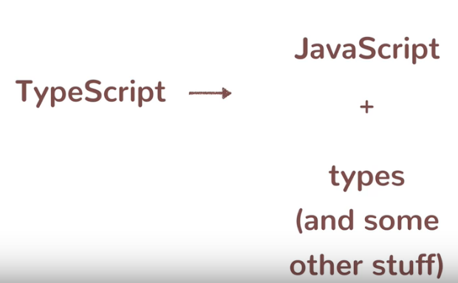
TypeScript versus JavaScript

Slide 9
Get Up and Running with TS
Install Visual Studio Code
Install Node JS
To compile TS
To run TS
Install the TypeScript Compiler
Notes:
https://www.icontemp.com/typ/
Course:
https://www.tutorialspoint.com/typescript/
https://learnxinyminutes.com/docs/typescript/ !!!!

Slide 10
Node -v
Npm -v
Npm install typescript –g
tsc -v
To compile and run a new ts file:
tsc hello-world.ts
node hello-world.js

Slide 11
Type declarations
See code

Slide 12
TypeScript classes
class Person{
firstName;
lastName;
}

Slide 13
Methods and constructors
Overloading constructor is not allowed in TS.

Slide 14
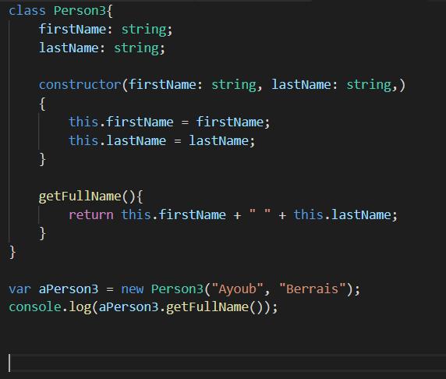
Methods and constructors

Slide 15
Inheritance and Polymorphism In TypeScript

Slide 16
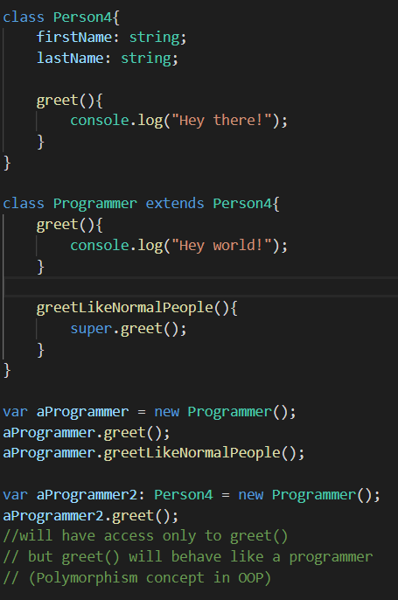

Slide 17
Interfaces and Duck Typing

Slide 18
Exercices
Java OO exercises in TS

Slide 19
https://training-course-material.com/training/Typescript#Exercise_4_.E2.8C.98
Notes:
https://www.icontemp.com/typ/
Course:
https://www.tutorialspoint.com/typescript/
https://learnxinyminutes.com/docs/typescript/ !!!!

Slide 20
Angular 7

Slide 21
Angular
Angular (commonly referred to as "Angular 2+" or "Angular v2 and above")^{[4][5]} is a TypeScript-based open-source web application framework led by the Angular Team at Google and by a community of individuals and corporations. Angular is a complete rewrite from the same team that built AngularJS.

Slide 22
Components

Slide 23
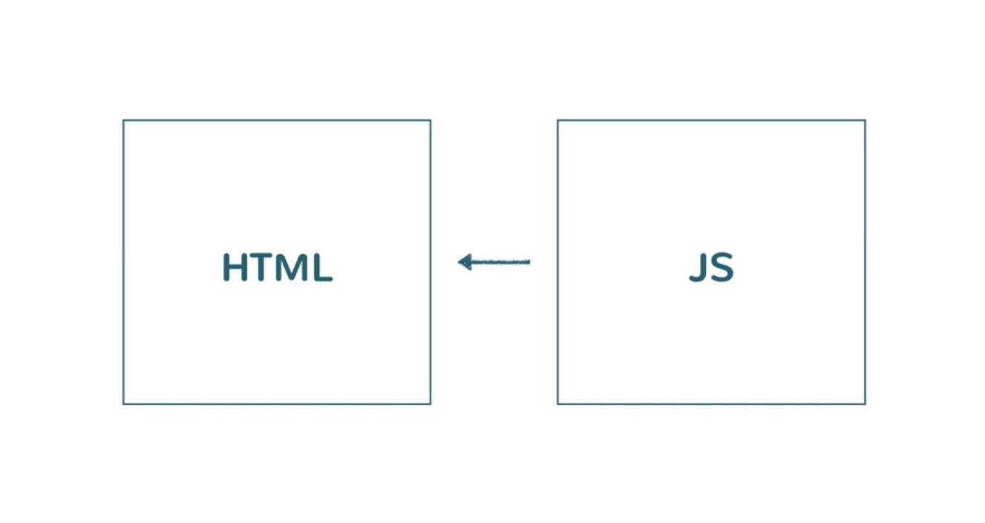
Old Approach

Slide 24
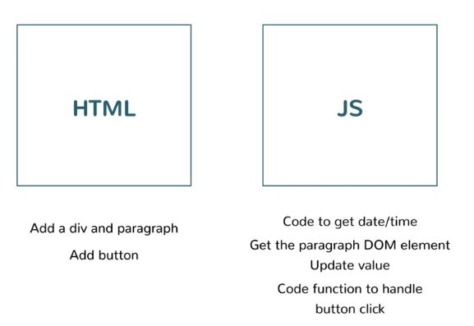
Old Approach

Slide 25
Component Based Model

Slide 26
Component Based Model
Think in term of components
Component can be reused
Use a tag to declare your component so it can be reused

Slide 28
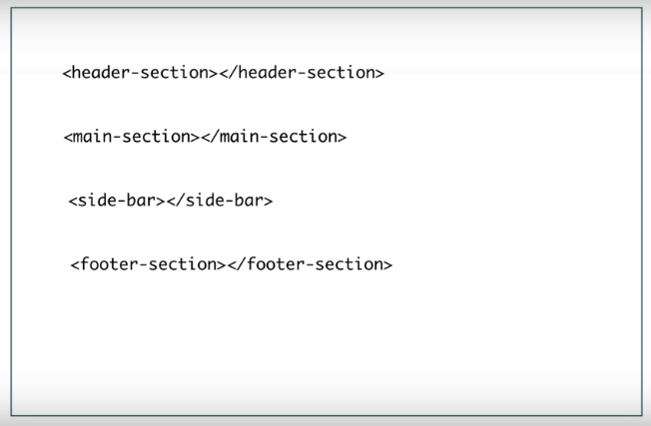

Slide 29
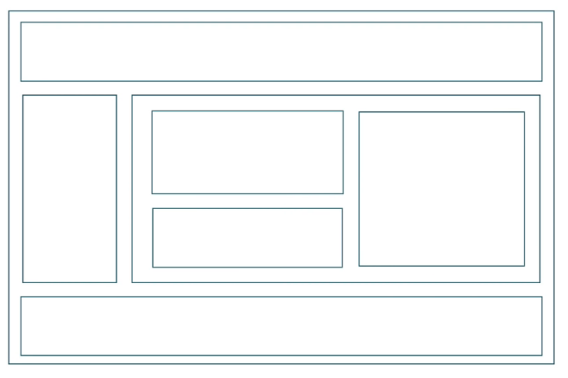
Subcomponents

Slide 31
Structure of angular application

Slide 32
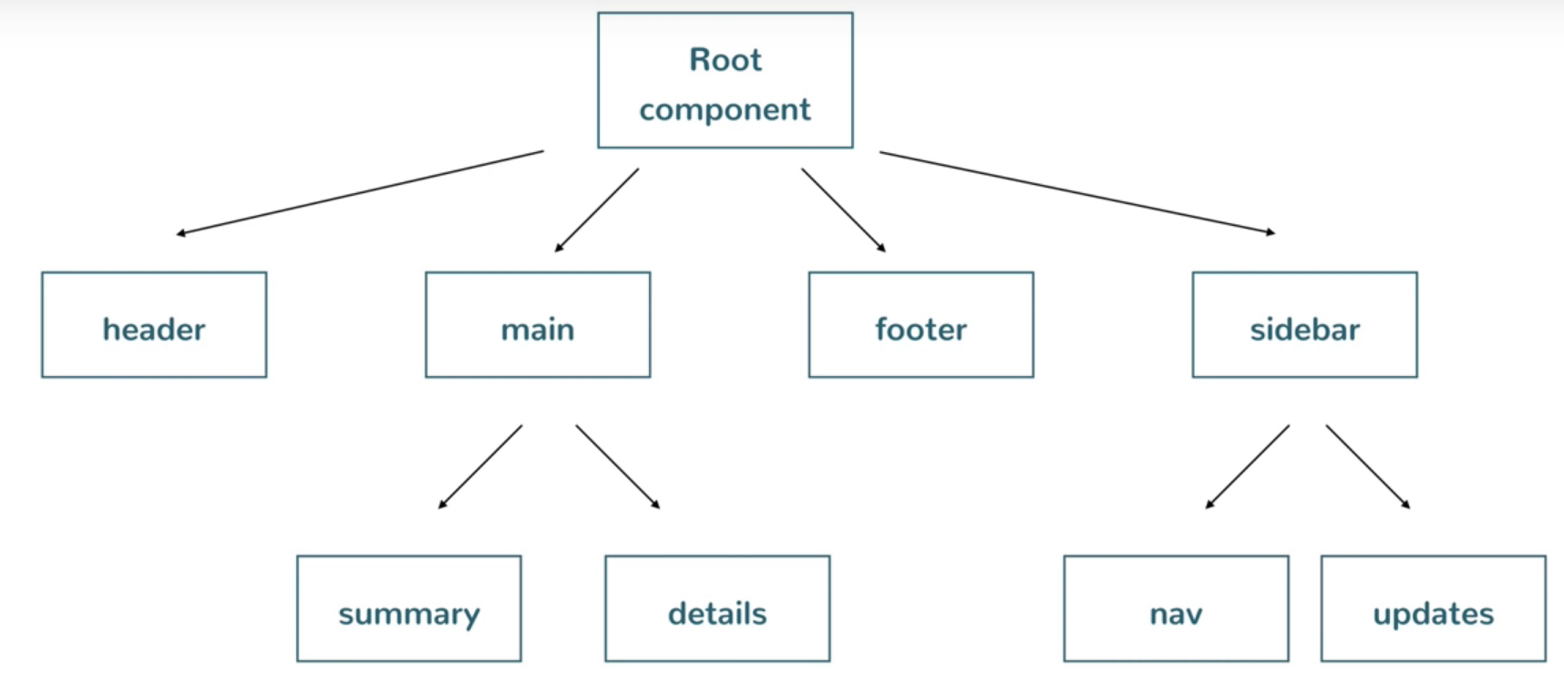

Slide 33
Back to Date use case

Slide 34
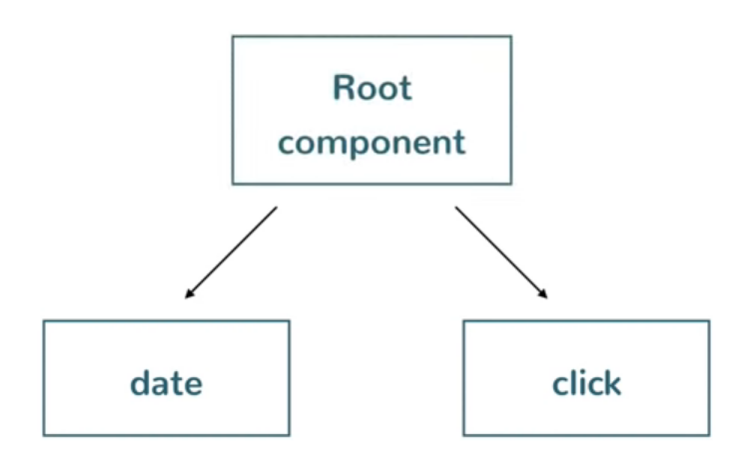
Date use case in angular way

Slide 35
Setting up
Install NodeJS
Install Visual Studio Code
Install Angular CLI (Command Line Interface)
npm install @angular/cli –g
(sometimes should be inversed: npm install –g @angular/cli)
ng version
Notes:
npm install @angular/cli@6.0.0

Slide 36
Setting up

Slide 37
Creating and running a project
ng new first-project
Open Visual Studio Code, Open this directory, and see the project hierarchy
ng serve (to run the server)
See http://localhost:4200/

Slide 38
Examine src folder
Examine inside it
Look at <app-root></app-root> (the root component)
You can see that component under app folder

Slide 39
Open html file and observe
Welcome to {{ title }}!
Change something (for example !!! instead of !)
Look again at the browser without refreshing => you will see the change
=> There is one to one mapping
Look at the ts file (app.component.ts)
Change “first-project” by “my first-project”
You will change on the browser without refreshing

Slide 40
Remark: app.component.spec.ts: for unit tests
Let’s get rid of all html content to build our own content
(Look at html => become empty)

Slide 41
Create new component
Stop the server
Create new component :
ng generate component hello-world
=> creates 4 files and updates app.module.ts on root of app folder
Look at created html file
Look at created ts file
Look at app-hello-world selector

Slide 42
Go to app.component.html
Fill it this sway
<h1>Hello</h1>
<app-hello-world></app-hello-world>
<h1>Hello</h1>
<app-hello-world></app-hello-world>

Slide 43
Let’s get back to date example
Create a date component
ng generate component date
Add new component to main html page and see how it is rendered
Let’s observe together content of ts script of date
TS script is the entry point for the component in angular

Slide 44
Try to change the html tag name
Try to change the html file name

Slide 45
Binding data from component class

Slide 46
Data Binding
Add in date ts component
message: string = "hello";
Reference it in date html file:
date works! {{message}}
Now chage message to
message: string = new Date().toDateString();
See the change directly applied in html page: This is data binding

Slide 47
Data Binding
Data Binding in Angular refers to binidng the data in the component instance to the HTML template. Any change to the data automatically get updated in the view.

Slide 48
Data Binding and async
Now we'll use an async operation (`setInterval`) to dynamically update the date component's displayed value, so that it shows updates to the time value every second.

Slide 49
Data Binding and async
Change
dateMessage: string;
constructor() {
let currentDate = new Date();
this.dateMessage = currentDate.toDateString() + ' ' + currentDate.toLocaleTimeString();
}
<p>
date works! {{dateMessage}}
</p>

Slide 50
Data Binding and async
Now include it in a fat arrow functions:
dateMessage: string;
constructor() {
setInterval(()=>{
let currentDate = new Date();
this.dateMessage = currentDate.toDateString() + ' ' + currentDate.toLocaleTimeString();
}, 1000);
}

Slide 51
Template Interpolation
the 'double-curly’ triggers angular to do interpolation
Evaluation
{{ 1 + 1 }}
Looking at what corresponds to what you write

Slide 52
Template Interpolation
What is inside is not a TS expression inside.
{{ addNumbers(someNumber, 6) }}
Above expression will not compile inside ts script. IT should be rather:
addNumbers(a: number, b: number)
{
return a + b;
}
someOtherMethod()
{
this.addNumbers(this.someNumber, 6);
}

Slide 53
Templates and Data Binding

Slide 54
Looping with ngFor
Create second project second-project
Clear default html and ts
Create address-card component
Create address info in html
Now I don’t want to hard code them.
Create user (any) with properties: name; title, address, phones
Notes:
ng new first-project
ng generate component first-component

Slide 55
Looping with ngFor
Now display them in html using curly braces.
We will need a for loop to display all phone numbers
<p *ngFor="let phoneNumber of user.Phone">{{phoneNumber}}</p>

Slide 56
Using ngIf
<div *ngIf="user.Phone.length">
<p>Phones:</p>
<p *ngFor="let phoneNumber of user.Phone">{{phoneNumber}}</p>
</div>

Slide 57
Passing inputs to components
import { Component, OnInit, Input } from '@angular/core';
@Input('name') userName: string;
// Initialization should be here:
ngOnInit() {
}
//dynamic name inside ngOnInit()
name: this.userName,
<app-address-card name="Ayoub Berrais"></app-address-card>

Slide 58
Using ngOnInit Lifecycle hook
Remark that previous init was not possible in constructor, but rather in ngOnInit().
See here:
https://angular.io/guide/lifecycle-hooks

Slide 59
Passing member variables to components
Create user.model.ts:
export class User{
name: string;
designation: string;
address: string;
Phone: string[];
}

Slide 60
Passing member variables to components
user: any;
@Input('user') userObj: User;
constructor() {
}
ngOnInit() {
this.user = {
name: this.userObj.name,
title: "Software Developer",
address: "1234, Main St, Lac1, 1053",
Phone:[
"123-456-7890",
"987-654-3210"
]
}
}

Slide 61
in address-card.component.ts
user: any;
@Input('user') userObj: User;
constructor() {
}
ngOnInit() {
this.user = {
name: this.userObj.name,
title: "Software Developer",
address: "1234, Main St, Lac1, 1053",
Phone:[
"123-456-7890",
"987-654-3210"
]
}
}

Slide 62
in app.component.ts
user: User;
constructor()
{
this.user = new User();
this.user.name = "Foo Bar";
this.user.designation = "Software Engineer";
this.user.address = "1000, Main Street, City";
this.user.Phone = [
"123-456-7890",
"987-654-3210"
]
}

Slide 63
in app.component.html
<app-address-card [user]="user"></app-address-card>

Slide 64
Styling Angular components
Add class attributes to address-card.component.html
<!-- Styling Angular components -->
<div class="address-card">
<h1 class="name">{{user.name}}</h1>
<h3 class="title">{{user.title}}</h3>
<p class="address">{{user.address}}</p>
<div class="phone" *ngIf="user.Phone.length">
<p>Phones:</p>
<p *ngFor="let phoneNumber of user.Phone">{{phoneNumber}}</p>
</div>
</div>

Slide 65
Styling Angular components
Fill some css rules in address-card.component.css
CSS is applied only to the component context. It will never be applied outside of it.
If you want general styling to all components, you should make it in style.css on root of the project
<app-address-card [user]="user"></app-address-card>
<div class="title">This is just a css test</div>

Slide 66
Handling click events
We'll now implement some interactivity by adding a button and having its click event trigger showing and hiding of a div. You'll learn how to wire in member methods to be executed on user events and how you can affect component state with them.

Slide 67
Two way data binding
We will learn how to use the `ngModel` directive to achieve two way data binding between the view and the component class. Learn how to bind a text input element to a member variable of your component class.
<input type="text" [(ngModel)]="inputText">
Using Banana in a Bracket
Don’t forget to import FormsModule in app.module.ts
import { FormsModule } from '@angular/forms';
imports: [
…
FormsModule
…
]

Slide 68
Services

Slide 69
What to learn
We will learn about services in Angular. Create services and inject them into components using dependency injection. Use the HttpClient service to make REST API calls and receive responses.

Slide 70
Creating and using multiple modules
We'll now examine the module file we've ignored all along in this course. You'll understand what Angular modules are and how you need to declare components that you need to be a part of a module. Learn how `NgModule` makes a class an Angular module.

Slide 71
ng new THIRD-PROJECT
Look at app.module.ts
ng generate module view
ng generate component view/view-component
Try to use <app-view-component/> inside app.component.html
=> will not work (See errors in console)

Slide 72
Should import it in app.module.ts
imports: [
BrowserModule,
ViewModule
],
Test it => still will not work

Slide 73
Should export the component also in view.module.ts:
exports: [
ViewComponentComponent
]
=> Now will work

Slide 74
Creating a service
If you want to create business services which have vues you wan create services.
ng generate service test
@Injectable => Angular Service
@NgModule => Angular Module
@Component => Angular Component

Slide 75
Creating a service
To use the service, it should be declared in module (in provider list).
providers: [TestService],
Let’s create a simple utility method in the service
How to use this service? should use Dependency Injection (DI)

Slide 76
DI
Dependency injection improves the reusability of your code by decoupling the creation of the usage of an object. That enables you to replace dependencies without changing the class that uses them. It also reduces the risk that you have to change a class just because one of its dependencies changed.
Dependency injection is a pattern through which to implement IoC, where the control being inverted is the setting of object's dependencies. The act of connecting objects with other objects, or “injecting” objects into other objects, is done by an assembler rather than by the objects themselves.

Slide 77
Using the service
Now look how we called the service in constructor of AppModule
constructor(private svc: TestService){
this.svc.printToConsole("Got the service");
}

Slide 78
Service Injection Context
Use the service in view component (in another module)
=> Services are provided for all modules (not like components)
All services become part of Shared Service Space (referenced as Dependency Injection context)

Slide 79
Making REST calls with HttpClient
Now we will learn how to use the inbuilt service `HttpClient` to make REST API calls and get data from external APIs.
Import the HttpClientModule in any of your modules (will do it in App module).
Update the App contructor to get http response.
Use Observale

Slide 80
Extending the sample app
Make user name of previous app dynamic (entered by the user)

Slide 81
Building an Angular project
See all js files that are loaded when loading an url
ng build
// look at dist folder that is created
npm install http-server –g
// host a directory on your machine as if it is hosting on CDN (Content delivery network)

Slide 82
Building an Angular project
http-server dist/THIRD-PROJECT/
// we will launch a server without ng serve
ng build -–prod
// to make optimization + minification + create hashes…

Slide 83
Routing

Slide 86
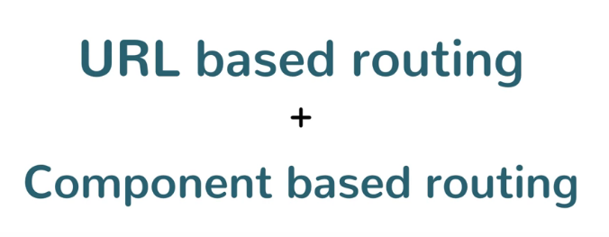

Slide 87
