Slide 1
Spring Boot

Slide 2
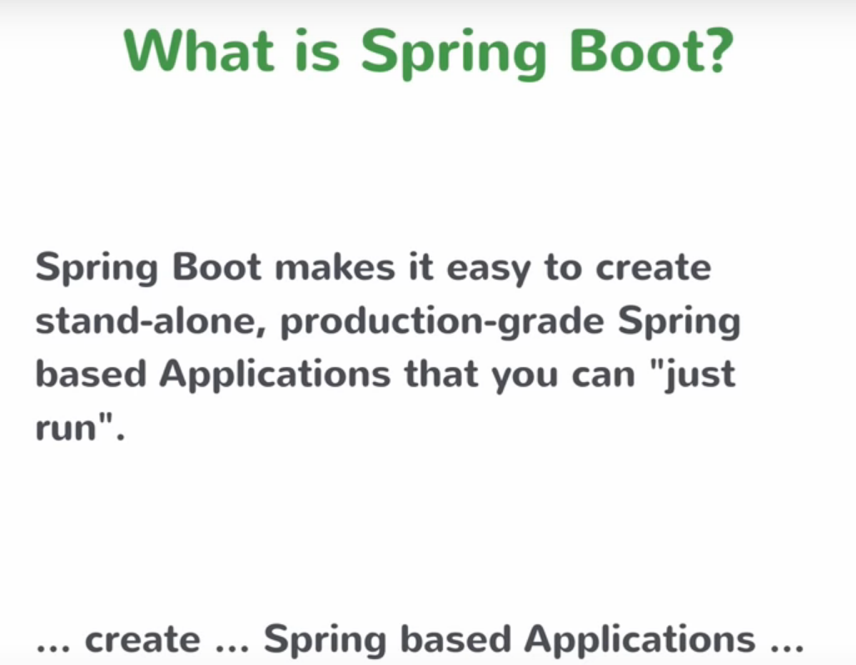

Slide 3
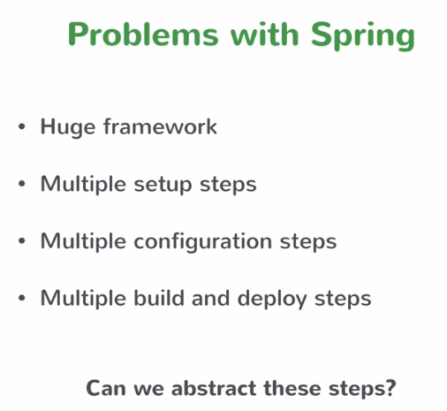

Slide 4
Creating a Spring Boot project
SpringBoot-01
Creating a Spring Boot project
https://start.spring.io/
Starting a Spring Boot application

Slide 5
Adding a REST Controller
SpringBoot-02
Add new controller to say hello.
The controller should be in a subpackage of the main

Slide 6
Returning Objects From Controller
SpringBoot-03

Slide 7
Creating a business service
SpringBoot-04

Slide 8
Getting a single resource
SpringBoot-05

Slide 9
Creating a new resource using POST
SpringBoot-06
Test it using PostMan:
https://www.getpostman.com/downloads/

Slide 10
Implementing Update and Delete
SpringBoot-07

Slide 11
Using application properties
SpringBoot-08
See all Common application properties here:
https://docs.spring.io/spring-boot/docs/2.1.9.RELEASE/reference/html/common-application-properties.html

Slide 12
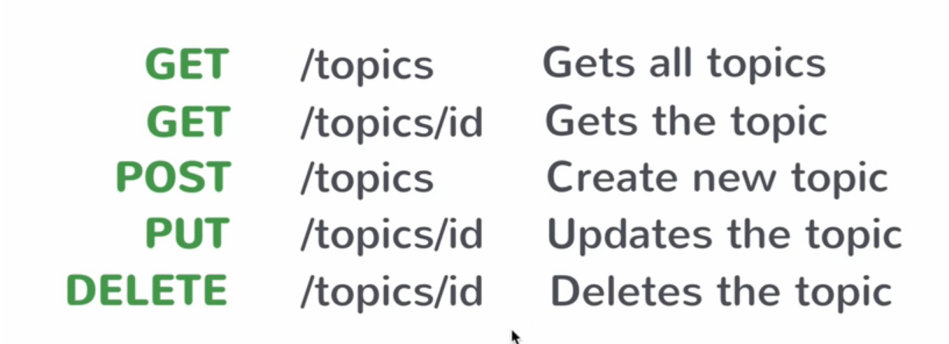
The REST API we builT

Slide 13
Spring data jpa
SpringBoot-09.1
Add jpa + derby dependency
Topic => @Entity
Creating TopicRepository

Slide 14
Making Crud Operations with Repository
SpringBoot-09.1 (follow up)
Autowire TopicRepository in TopicService
Update core of topicService methods
Test that persistence works well with PostMan

Slide 15
More about Spring data…
SpringBoot-09.2
How to search by criteria:
  in TopicRepository extends CrudRepository, define method with such name:
  findBy + field name (in camel case)
  If field name is of type another class, use class name + field name in another class
  Example:
  public List<Topic> findByDescription(String description);
  public List<Course> findByTopicId(String topicId);

Slide 16
More about Spring data…
More possibilities
public interface TopicRepository extends CrudRepository<Topic, String>{
  @Query("SELECT t.description FROM Topic t where t.id = :id")
  String findDescriptionById(@Param("id") String id);
}

Slide 17
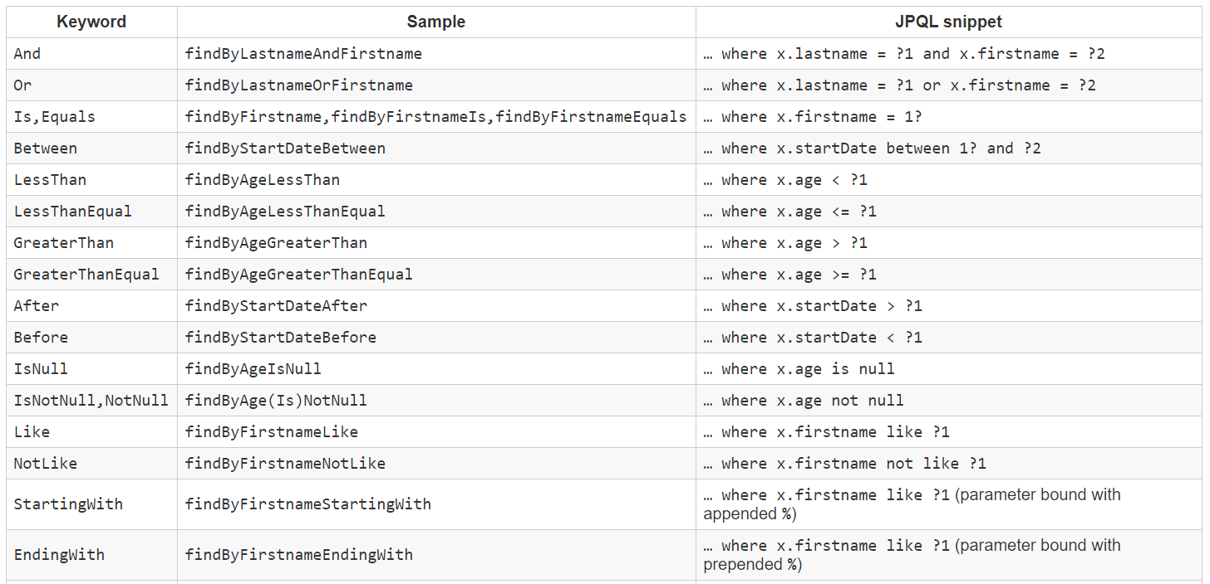
Supported keywords inside method names

Slide 18
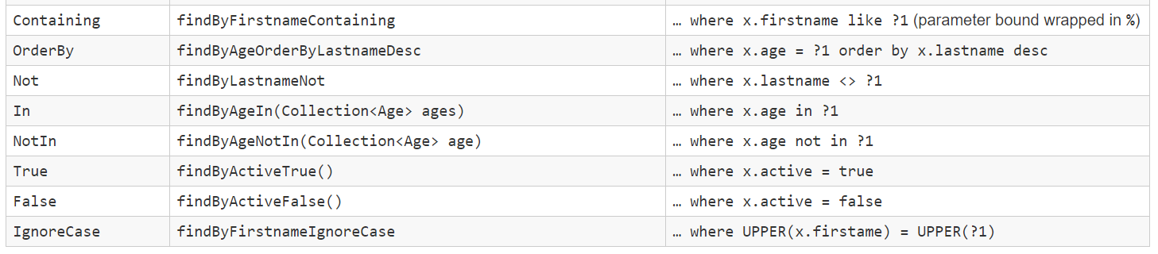
Supported keywords inside method names
https://docs.spring.io/spring-data/jpa/docs/1.5.0.RELEASE/reference/html/jpa.repositories.html

Slide 19
Adding Course APIs
SpringBoot-10
Course api + topic api
Each topic can have many courses
Add @ManyToOne to the topic member of the course
Extend the Repository
Change the call to get only courses of selected topic

Slide 20
Packaging and running a Spring Boot app
mvn clean install
java –jar target/demo3-0.0.1-SNAPSHOT.jar
You can also generate a war to deploy anywhere you want
Notes:
Actuator
http://localhost:8080/actuator
See here for more details:
https://www.callicoder.com/spring-boot-actuator/

Slide 21
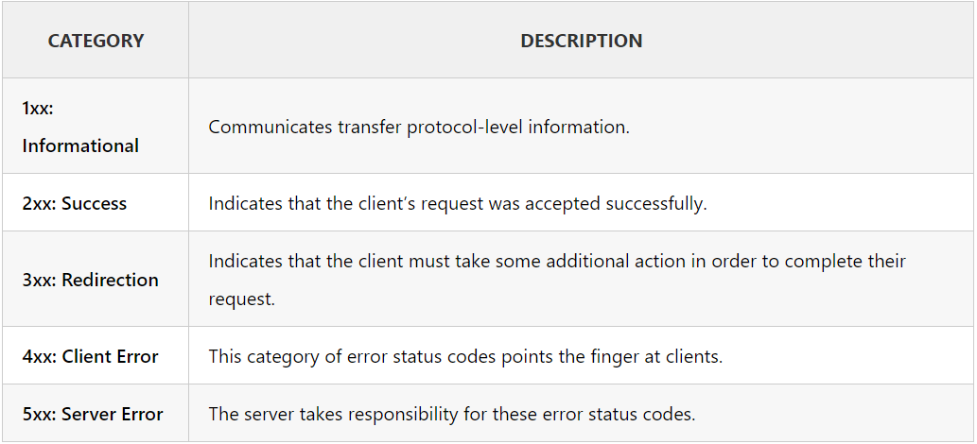
HTTP Status Codes
Notes:
Actuator
http://localhost:8080/actuator
See here for more details:
https://www.callicoder.com/spring-boot-actuator/

Slide 22
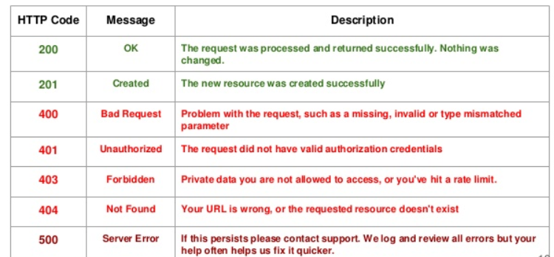
HTTP Status Codes
Notes:
Actuator
http://localhost:8080/actuator
See here for more details:
https://www.callicoder.com/spring-boot-actuator/

Slide 23
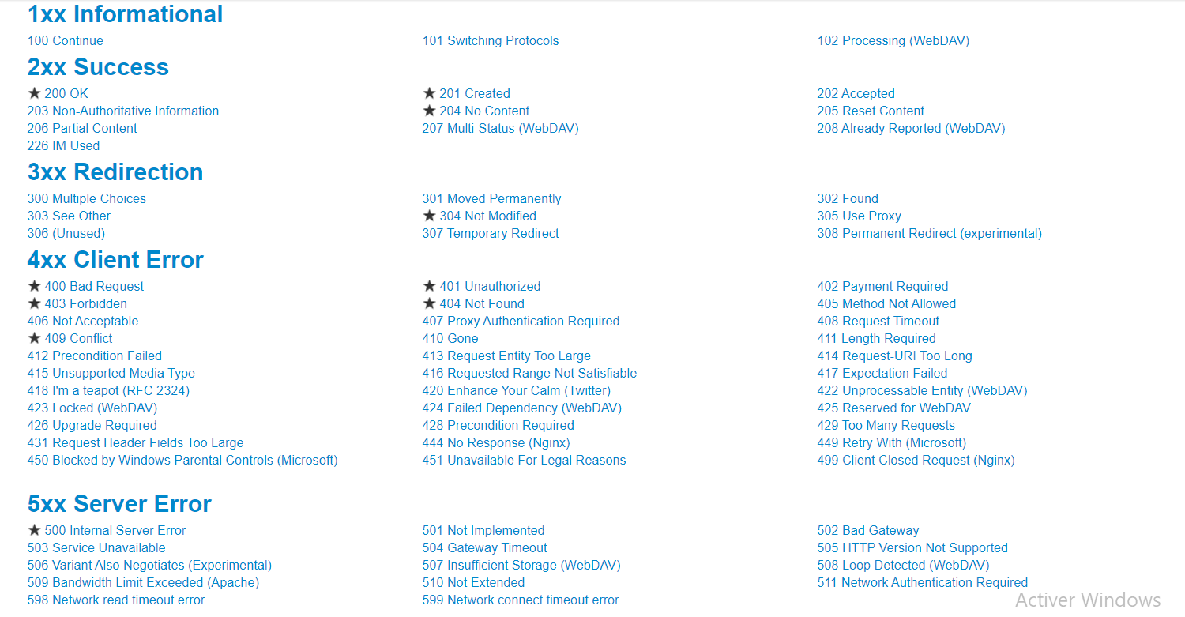
HTTP Status Codes
Notes:
Actuator
http://localhost:8080/actuator
See here for more details:
https://www.callicoder.com/spring-boot-actuator/

Slide 24
How to return HTTP Status Codes in Controller
Example
return ResponseEntity.noContent().build() // @DeleteMapping
return ResponseEntity.notFound().build() // @DeleteMapping
return new ResponseEntity<Todo>(todo, HttpStatus.OK); // @PutMapping
return ResponseEntity.created(uri).build(); // @PostMapping
Notes:
See SpringSec-Todos-05-restful-web-services-03-jpa

Slide 25
Actuator
SpringBoot-11
<dependency>
<groupId>org.springframework.boot</groupId>
<artifactId>spring-boot-starter-actuator</artifactId>
</dependency>
http://localhost:8080/actuator
You can enable / disable actuator endpoints. See here for more details:
https://www.callicoder.com/spring-boot-actuator/
Notes:
Actuator
http://localhost:8080/actuator
See here for more details:
https://www.callicoder.com/spring-boot-actuator/

Slide 26
Swagger

Slide 27
Adding Swagger Dependencies
SpringBoot12_SwaggerSample1
<dependency>
<groupId>io.springfox</groupId>
<artifactId>springfox-swagger2</artifactId>
<version>2.9.2</version>
</dependency>
<dependency>
<groupId>io.springfox</groupId>
<artifactId>springfox-swagger-ui</artifactId>
<version>2.9.2</version>
</dependency>

Slide 28
Adding Swagger ANNOTATION
@SpringBootApplication
@Configuration
@EnableSwagger2
http://localhost:8080/swagger-ui.html
http://localhost:8080/v2/api-docs

Slide 29
Spring SECURITY

Slide 30
Base Project To Work ON
SpringSec-Todos-01-restful-web-services

Slide 31
Setting up Spring Security
SpringSec-Todos-02-restful-web-services
add to pom.xml
<dependency>
<groupId>org.springframework.boot</groupId>
<artifactId>spring-boot-starter-security</artifactId>
</dependency>

Slide 32
Setting up Spring Security
SpringSec-Todos-02.1-restful-web-services
add to pom.xml
<dependency>
<groupId>org.springframework.boot</groupId>
<artifactId>spring-boot-starter-security</artifactId>
</dependency>

Slide 33
Setting up Spring Security
restart the server, see in logs something similar to:
Using generated security password: bc9891ac-19d1-4461-851d-94c2b65cbf7f
open http://localhost:8080
you will be redirected to: http://localhost:8080/login
user / bc9891ac-19d1-4461-851d-94c2b65cbf7f
then you can now request your api
TEST WITH POSTMAN (use Basic Authentication)
http://localhost:8080/users/ayoub/todos

Slide 34
Setting up Spring Security
SpringSec-Todos-02.2-restful-web-services
Configure standard userid and password
in application.properties, add:
spring.security.user.name=ayoub
spring.security.user.password=dummy

Slide 35
Configure Spring Security
com.hc.jee.webservices.day27restfulwebservices.basic.auth
Configure Spring Security to disable CSRF and enable OPTION Requests:
  create package com.hc.jee.webservices.day27restfulwebservices.basic.auth
  create class SpringSecurityConfigurationBasicAuth
  extends WSCA (WebSecurityConfigurerAdapter)
  reimplement configure(HttpSecurity http) (copy its code from WSCA)

Slide 36
Configure Spring Security
annotate the whole class by:
@Configuration
@EnableWebSecurity
add @Override at the method (jus a convention, not really needed)
comment // .formLogin().and()
add .csrf().disable()
add .antMatchers(HttpMethod.OPTIONS, "/**").permitAll()

Slide 37
Configure Spring Security
It becomes thus:
@Override
protected void configure(HttpSecurity http) throws Exception {
http
.csrf().disable()
.authorizeRequests()
.antMatchers(HttpMethod.OPTIONS, "/**").permitAll()
.anyRequest().authenticated()
.and()
// .formLogin().and()
.httpBasic();
}

Slide 38
basic authentication encode base64
FE Call Sample
intercept(req: HttpRequest<any>, next: HttpHandler){
let username = 'ayoub'
let password = 'dummy'
let basicAuthHeaderString = 'Basic ' + window.btoa(username + ':' + password);
req = req.clone({
setHeaders: {
Authorization: basicAuthHeaderString
}
});
return next.handle(req);
}

Slide 39
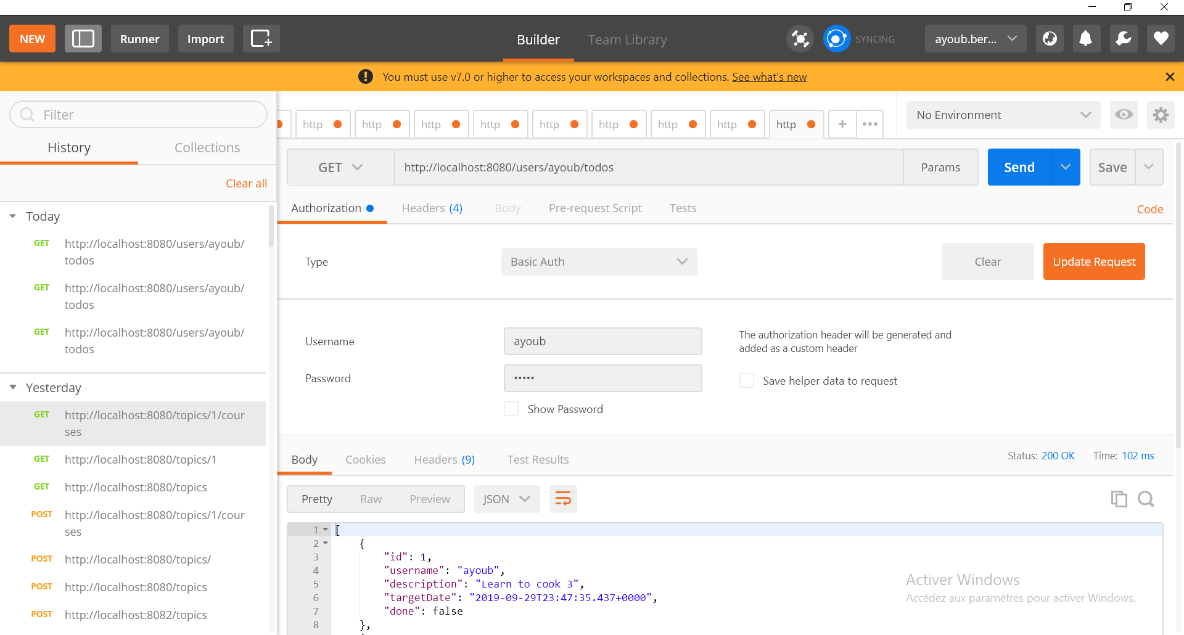
TEST BASIC AUTHN WITH POSTMAN

Slide 40
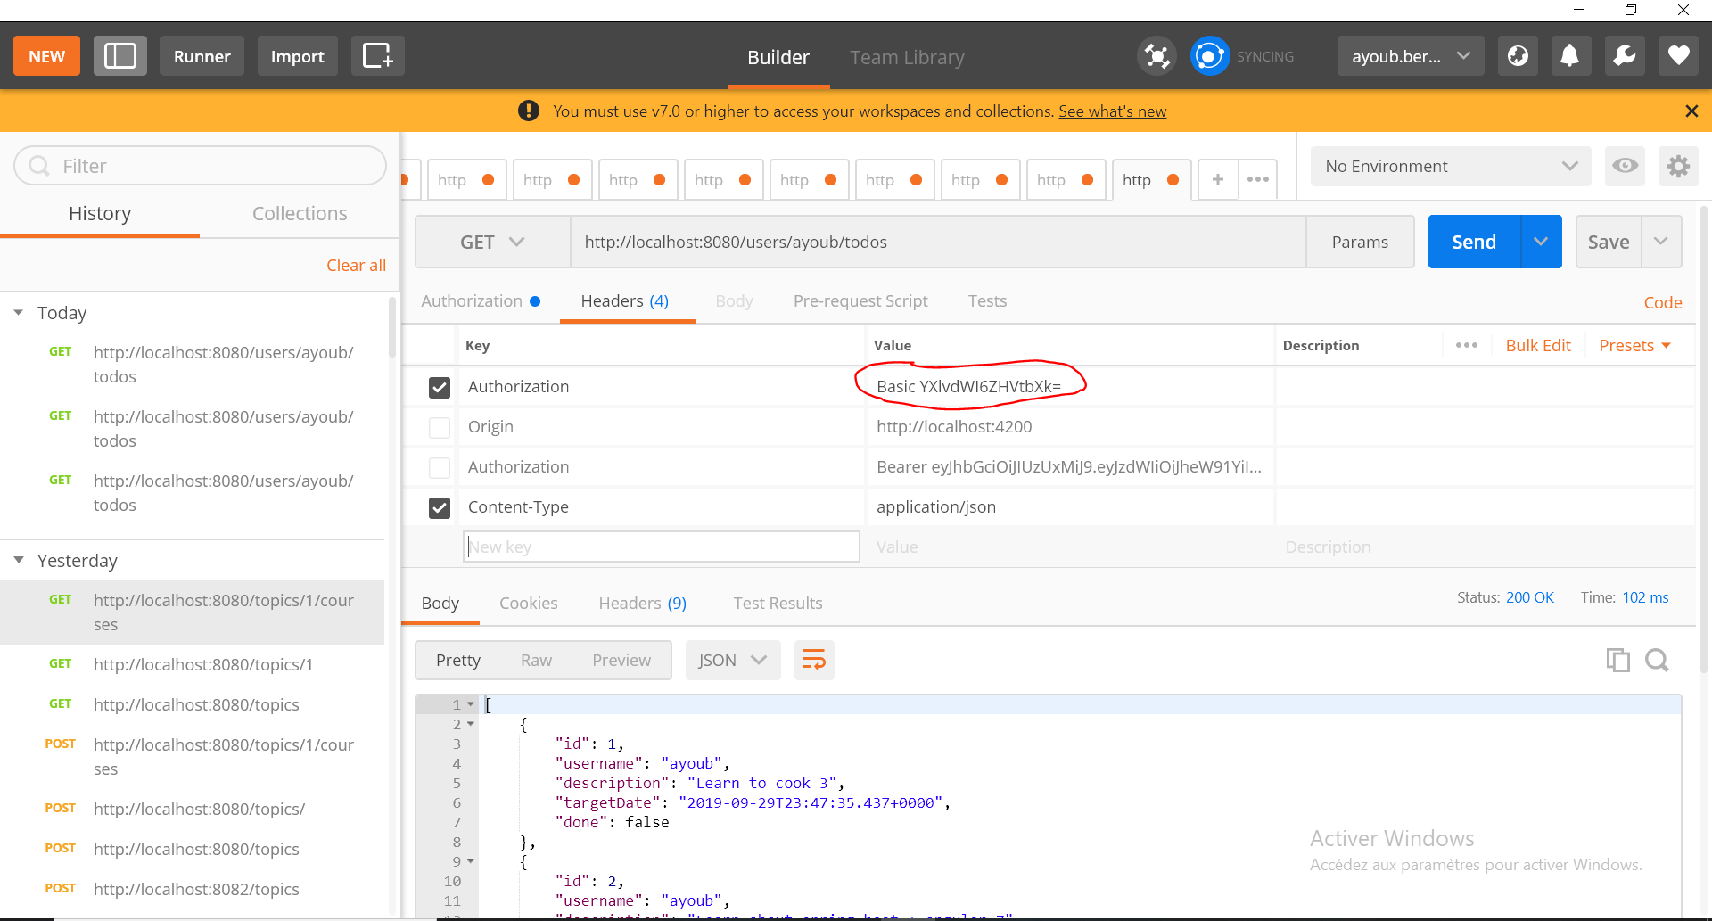
TEST BASIC AUTHN WITH POSTMAN

Slide 41
Connecting Spring Security and Spring Boot with JWT Framework
A JWT technically is a mechanism to verify the owner of some JSON data. It’s an encoded string, which is URL safe, that can contain an unlimited amount of data (unlike a cookie), and it’s cryptographically signed.
When a server receives a JWT, it can guarantee the data it contains can be trusted because it’s signed by the source. No middleman can modify a JWT once it’s sent.

Slide 42
Importing JWT Framework into Eclipse
SpringSec-Todos-04-restful-web-services-02-jwt
add
<dependency>
<groupId>io.jsonwebtoken</groupId>
<artifactId>jjwt</artifactId>
<version>0.9.1</version>
</dependency>

Slide 43
Importing JWT Framework into Eclipse
In application.properties:
jwt.signing.key.secret=mySecret
jwt.get.token.uri=/authenticate
jwt.refresh.token.uri=/refresh
jwt.http.request.header=Authorization
jwt.token.expiration.in.seconds=604800

Slide 44
Importing JWT Framework into Eclipse
create package com.hc.jee.webservices.day27restfulwebservices.jwt
copy the jwt classes

Slide 45
Importing JWT Framework into Eclipse
request via POSTMA: http://localhost:8080/users/ayoub/todos
=> 401
You would need to provide the Jwt Token to Access This resource

Slide 46
Importing JWT Framework into Eclipse
Generate a Bcrypted password with BcryptEncoderTest.java utility
Copy one of the generated crypted password in JwtInMemoryUserDetailsService.java
inMemoryUserList.add(new JwtUserDetails(1L, "ayoub",
"$2a$10$pONGA8TzcwT75WAnFuJvxOVOS/T55R0UYSiTYQRUZ1GZOOLaJStAu", "ROLE_USER_2"));

Slide 47
Importing JWT Framework into Eclipse
How to get a JWT token:
http://localhost:8080/authenticate
in body:
{
"username": "ayoub",
"password": "dummy"
}

Slide 48
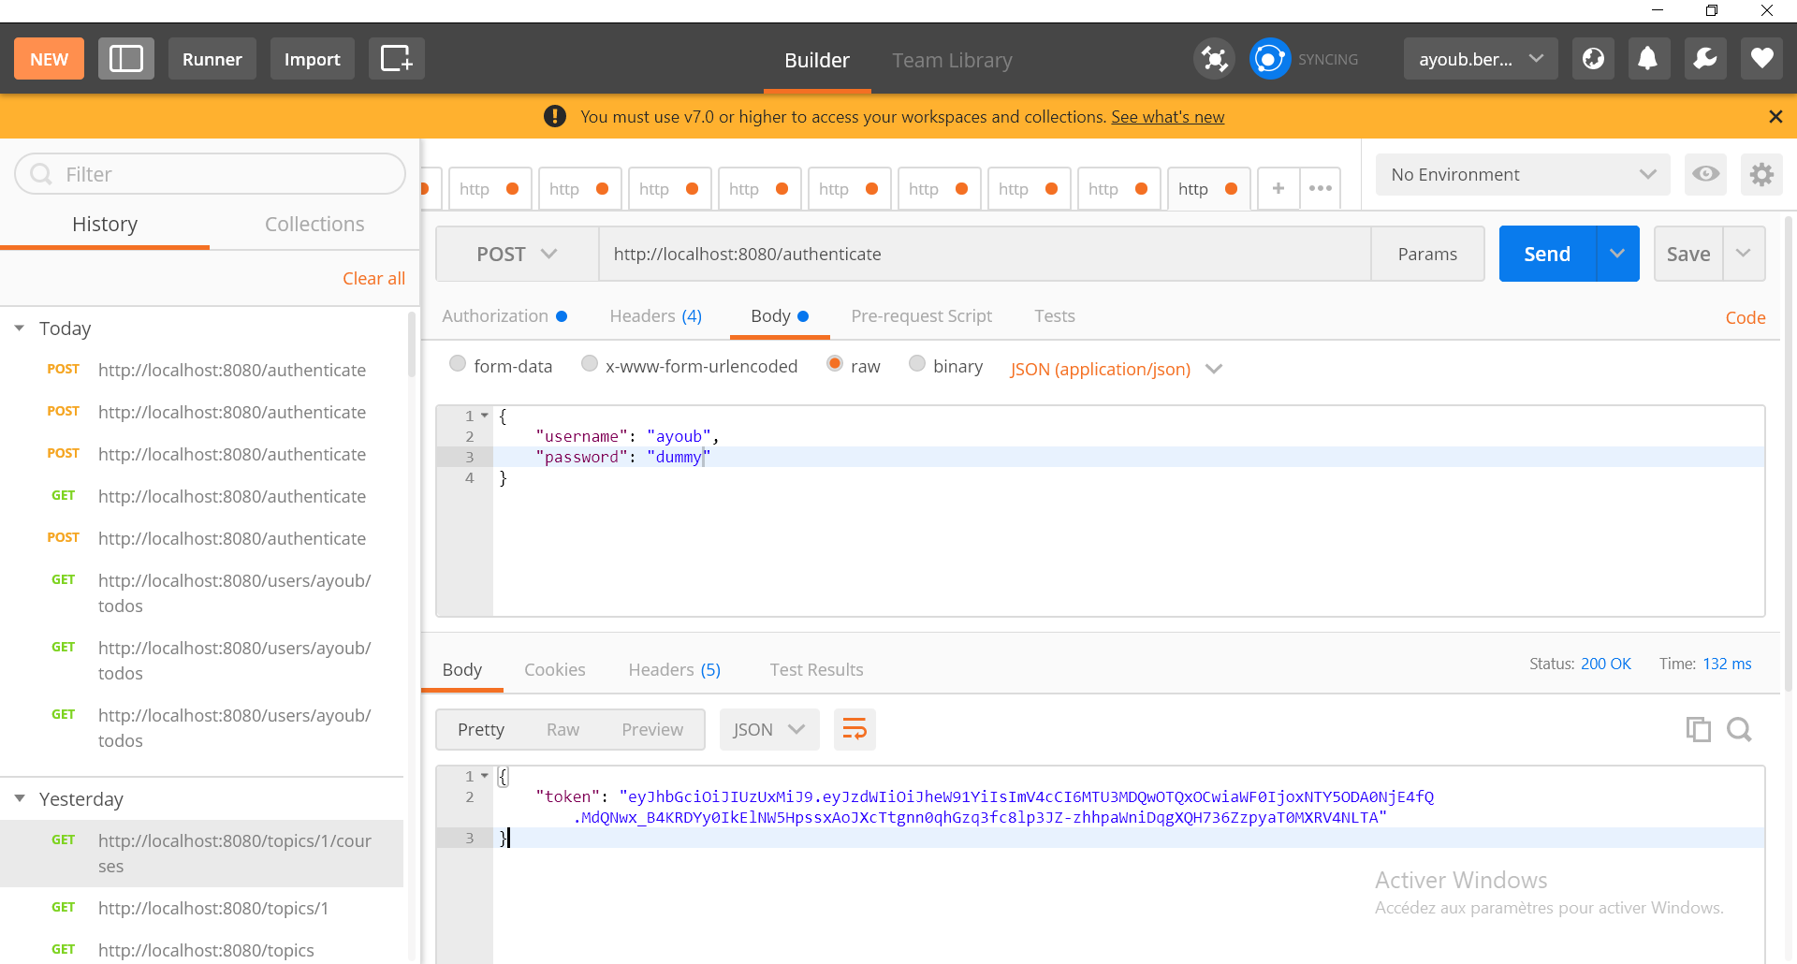
Importing JWT Framework into Eclipse

Slide 49
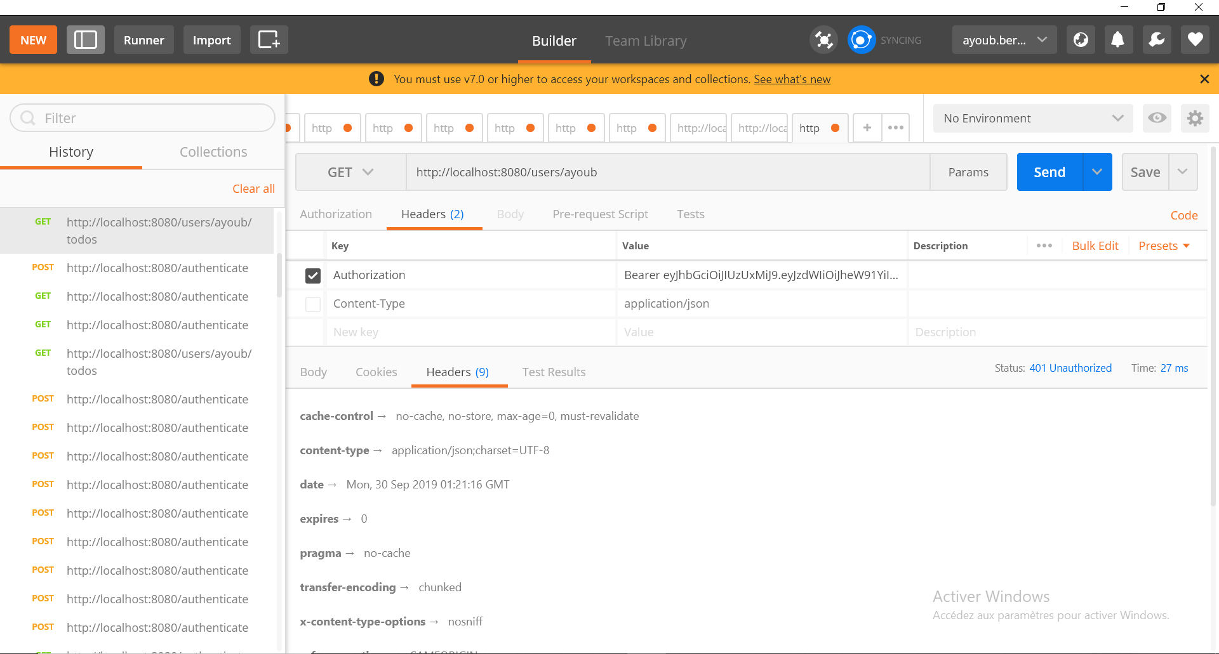
Importing JWT Framework into Eclipse

Slide 50
Oauth2
OAuth2 is, you guessed it, the version 2 of the OAuth protocol (also called framework). This protocol allows third-party applications to grant limited access to an HTTP service, either on behalf of a resource owner or by allowing the third-party application to obtain access on its own behalf

Slide 51
Oauth2
SpringSecurityConfigurationOauth2Auth
<dependency>
<groupId>org.springframework.security.oauth.boot</groupId>
<artifactId>spring-security-oauth2-autoconfigure</artifactId>
<version>2.1.8.RELEASE</version>
</dependency>
@EnableOAuth2Sso
On SpringSecurityConfigurationOauth2Auth

Slide 52
Oauth2
In SpringSecurityConfigurationOauth2Auth:
@Override
protected void configure(HttpSecurity http) throws Exception {
http
.csrf().disable()
.authorizeRequests().antMatchers("/login").permitAll()
.anyRequest().authenticated();
}

Slide 53
Oauth2
https://console.developers.google.com/
New Project : Audaxis
Credentials
Application Name: Audaxis
See Scope
Save

Slide 54
Oauth2
Create credentials
Oauth client ID
Web Application
Name: Audaxis App
Authorized Javascript Origin: http://localhost:8080
Authorized Redirect Url: http://localhost:8080/login
Create

Slide 55
Oauth2
Save Client Id and client secret
Copy them in application.properties

Slide 56
Oauth2
security.oauth2.client.clientId=330515216826-h0l3146d9cp9f0jnpr0nn2ba9djahsri.apps.googleusercontent.com
security.oauth2.client.clientSecret=kZFVmZd9FFLU3pxSCHb_R8rB
security.oauth2.client.accessTokenUri=https://www.googleapis.com/oauth2/v3/token
security.oauth2.client.userAuthorizationUri=https://accounts.google.com/o/oauth2/auth
security.oauth2.client.tokenName=oauth_token
security.oauth2.client.authenticationScheme=query
security.oauth2.client.clientAuthenticationScheme=form
security.oauth2.client.scope=profile email
#security.oauth2.resource.user-info-uri=https://www.googleapis.com/userinfo/v2/me
security.oauth2.resource.userInfoUri=https://www.googleapis.com/userinfo/v2/me
security.oauth2.resource.preferTokenInfo=false

Slide 57
Oauth2
Now request any resource from the browser like:
http://localhost:8080/users/ayoub/todos#
You will be redirected to login against google

