Slide 1
Microservices & Spring Cloud

Slide 2
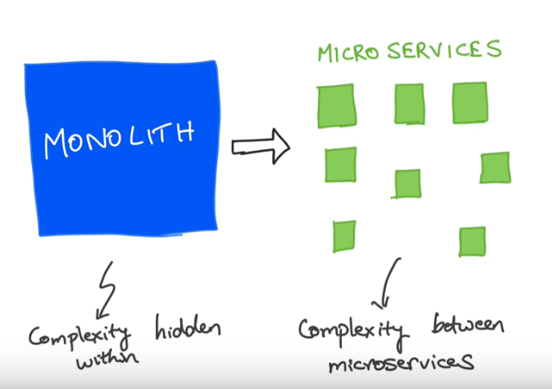

Slide 3
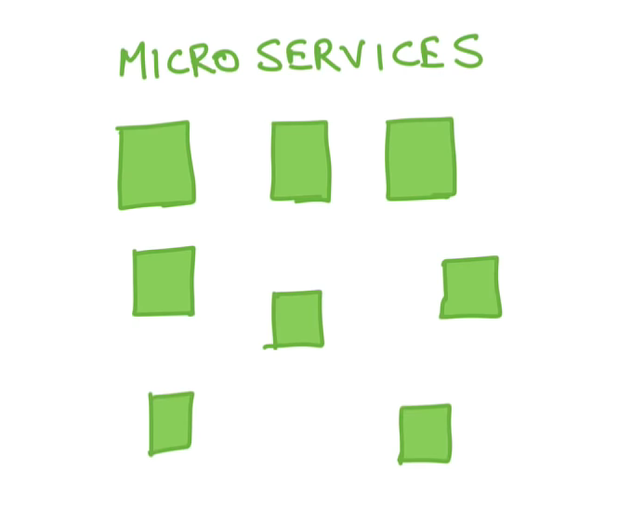

Slide 4
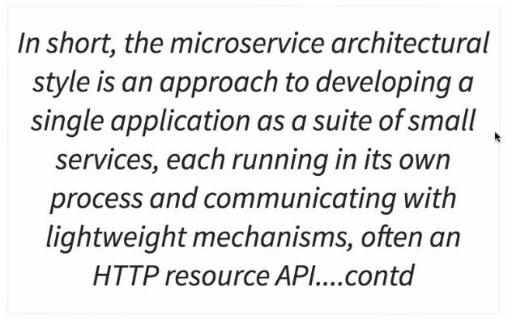
Introduction to Microservices

Slide 5
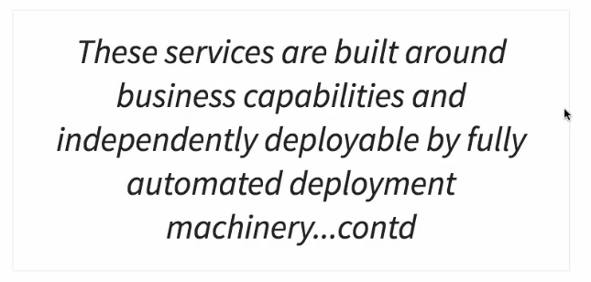
Introduction to Microservices

Slide 6
Introduction to Microservices

Slide 7
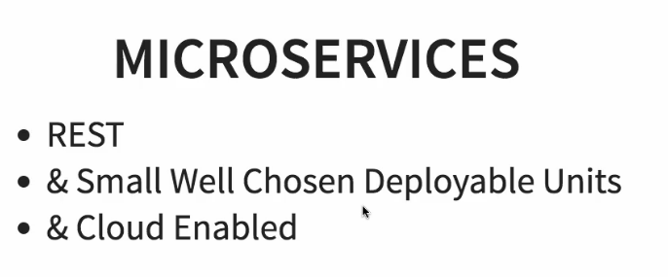
Introduction to Microservices

Slide 8
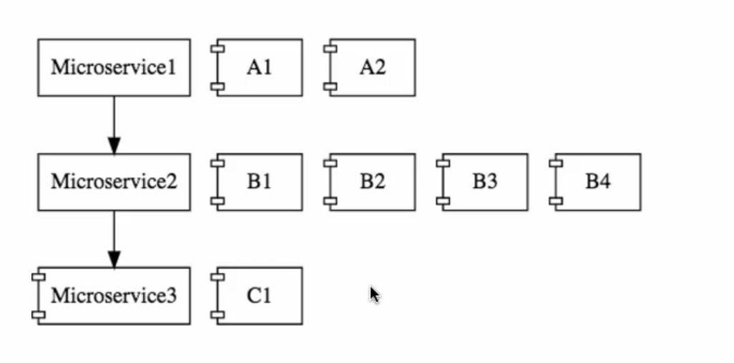
Introduction to Microservices

Slide 9
Introduction to Spring Cloud
https://spring.io/projects/spring-cloud

Slide 10
Introduction to Spring Cloud

Slide 11
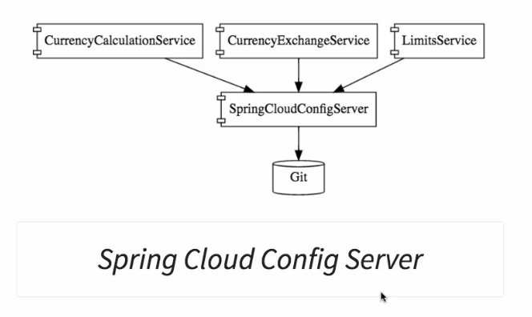
Introduction to Spring Cloud

Slide 12
Introduction to Spring Cloud

Slide 13
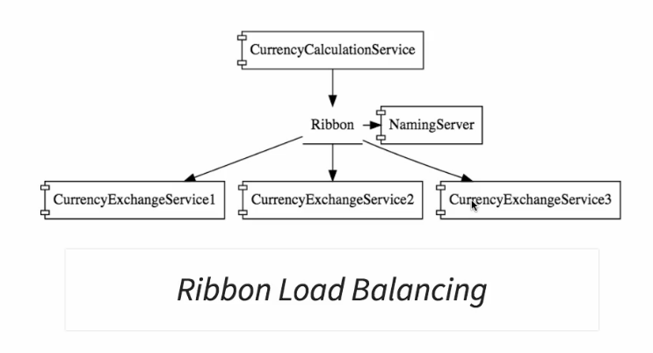
Introduction to Spring Cloud

Slide 14
Introduction to Spring Cloud

Slide 15
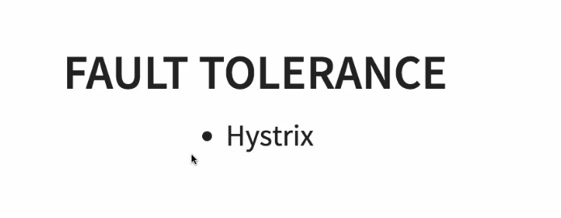
Introduction to Spring Cloud

Slide 16
Advantages of Microservices Architectures

Slide 17
Advantages of Microservices Architectures

Slide 18
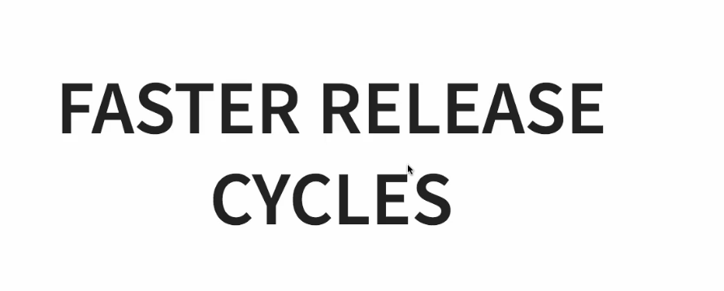
Advantages of Microservices Architectures

Slide 19
Microservice Components - Standardizing Ports and URL
Application | Port
Limits Service | 8080, 8081, ...
Spring Cloud Config Server | 8888
Currency Exchange Service | 8000, 8001, 8002, ..
Currency Conversion Service | 8100, 8101, 8102, ...
Netflix Eureka Naming Server | 8761
Netflix Zuul API Gateway Server | 8765
Zipkin Distributed Tracing Server | 9411

Slide 20
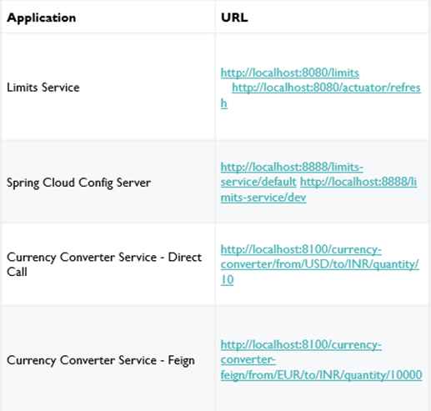
Urls

Slide 21
Urls
Currency Exchange Service | http://localhost:8000/currency-exchange/from/EUR/to/INR http://localhost:8001/currency-exchange/from/USD/to/INR
Eureka | http://localhost:8761/
Zuul - Currency Exchange & Exchange Services | http://localhost:8765/currency-exchange-service/currency-exchange/from/EUR/to/INRhttp://localhost:8765/currency-conversion-service/currency-converter-feign/from/USD/to/INR/quantity/10
Zipkin | http://localhost:9411/zipkin/
Spring Cloud Bus Refresh | http://localhost:8080/bus/refresh

Slide 22
Intro to Limits Microservices and Spring Cloud Config Server

Slide 23
Intro to Limits Microservices and Spring Cloud Config Server
Create a spring boot project
Name: limits-service
Dependencies:
Web
Devtool
Actuator
Config client

Slide 24
Limits Microservices and Spring Cloud Config Server
Install eclipse STS:
https://spring.io/tools3/sts/all
With STS:
you can better start and stop any project inside many launched projects
you can stop all launched projects in one click
You have auto complete feature enables on application.properties
Import project into STS
In case pom.xml has errors:
change 2.1.8.RELEASE version of springboot to 2.1.4.RELEASE.
Project -> Maven -> Update project

Slide 25
Limits Microservices and Spring Cloud Config Server
limits-service-01:
Create LimitsConfigurationController
Test the urls
limits-service-02:
Set min and max in application.properties
Load those values through a Configuration Spring component

Slide 26
Setting up Spring Cloud Config Server
spring-cloud-config-server-03:
Create a new spring cloud config server
Using dependencies: Config Server, Devtools, web
Set project name and ports in properties
Install Git
https://git-scm.com/

Slide 27
Setting up Spring Cloud Config Server
mkdir git-localconfig-repo
cd git-localconfig-repo
git init //create new git repository
In eclipse spring cloud config server project, add a ling to that git config folder:
Right click on the project -> Build Path -> Link Source -> Browse to the folder
Create inside a new text file: limits-service.properties
Fill inside limits-service.properties
limits-service.minimum=8
limits-service.maximum=888

Slide 28
Setting up Spring Cloud Config Server
git config --global user.email "you@example.com"
git config --global user.name "Your Name"
git add –A //add all files
git commit –m « first commit»
IF YOU WANT SOME UNEXPLAINED ERROR WITH GITBASH, USE WINDOWS CMD

Slide 29
Setting up Spring Cloud Config Server
@EnableConfigServer
spring.cloud.config.server.git.uri=file://C:/udir/daily/2019/Audaxis/code/jworkspace/SPRING_CLOUD/git-localconfig-repo
http://localhost:8888/limits-service/default

Slide 30
Configuration for Multiple Environments in Git Repository
Add limits-service-dev.properties
And limits-service-qa.properties
git add –A
git commit –m «Dev and QA properties»
See http://localhost:8888/limits-service/dev
http://localhost:8888/limits-service/qa

Slide 31
Connect Limits Service to Spring Cloud Config Server
limits-service-03
application.properties => bootstrap.properties (loaded before application.properties)
Delete local properties: max and min
spring.cloud.config.uri=http://localhost:8888
Start limits-service
Test http://localhost:8080/limits

Slide 32
Configuring Profiles for Limits Service
limits-service-04
In bootstrap.properties of limits service, spring.profiles.active=dev
For any change in properties:
Commit changes
Restart client

Slide 33
Create a simple hard coded currency exchange service
currency-exchange-service-05
spring.application.name=currency-exchange-service
Depedencies: web, actuator, devtool
server.port=8000
Test it on: http://localhost:8000/currency-exchange/from/USD/to/TND

Slide 34
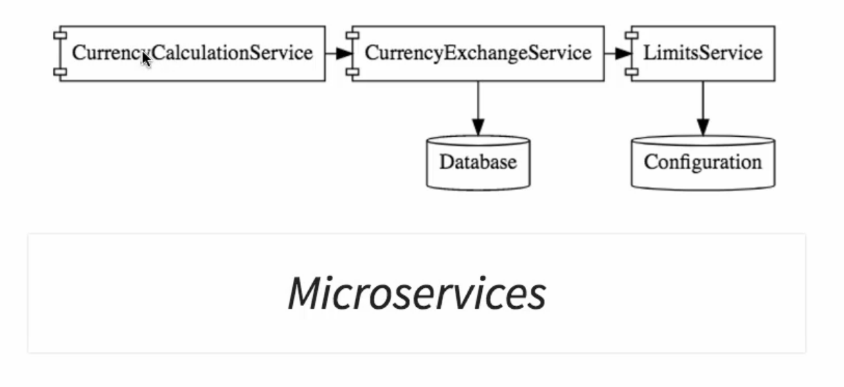
Setting up Dynamic Port in the the Response

Slide 35
Setting up Dynamic Port in the the Response
We will create many instances of CurrencyExchangeService.
We will add port just to distinguish them from their responses.
currency-exchange-service-06
Add 2 run configurations on eclipse to run the instances on 2 ports:
Add in VM arguments: -Dserver.port=8001
Test:
http://localhost:8000/currency-exchange/from/USD/to/TND
http://localhost:8001/currency-exchange/from/USD/to/TND

Slide 36
Configure JPA and Initialized Data
currency-exchange-service-07
<dependency>
<groupId>org.springframework.boot</groupId>
<artifactId>spring-boot-starter-data-jpa</artifactId>
</dependency>
<dependency>
<groupId>com.h2database</groupId>
<artifactId>h2</artifactId>
</dependency>

Slide 37
Configure JPA and Initialized Data
Annotate ExchangeValue entity
Initialize data with data.sql
spring.jpa.show-sql=true
spring.h2.console.enabled=true
Test:
http://localhost:8000/h2-console/
http://localhost:8001/h2-console/
Driver Class: org.h2.Driver
JDBC URL: jdbc:h2:mem:testdb
User Name: sa
Password

Slide 38
Create a JPA Repository
currency-exchange-service-08

Slide 39
Setting up Currency Conversion Microservices
Create new microservice: currency-conversion-service
currency-conversion-service-09
spring.application.name=currency-conversion-service
server.port=8100

Slide 40
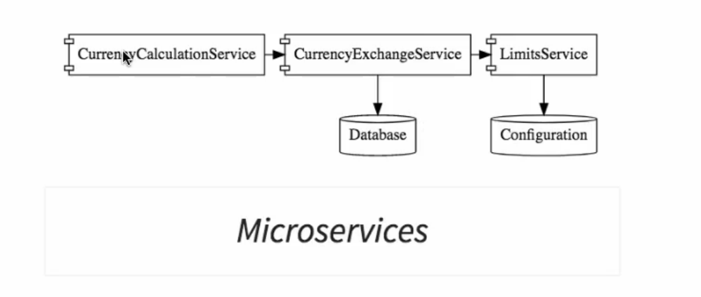
Creating a service for currency conversion

Slide 41
Creating a service for currency conversion
currency-conversion-service-09
Test on: http://localhost:8100/currency-converter/from/EUR/to/TND/quantity/100

Slide 42
Invoking Currency Exchange Microservices from Currency Conversion Micro
currency-conversion-service-10
Using RestTemplate
Testing with: http://localhost:8100/currency-converter/from/EUR/to/TND/quantity/100

Slide 43
Using Feign REST Client for Service Invocation
Feign is a Netflix rest client to make a simpler way to make rest call services
currency-conversion-service-11

Slide 44
Using Feign REST Client for Service Invocation
<dependency>
<groupId>org.springframework.cloud</groupId>
<artifactId>spring-cloud-starter-config</artifactId>
</dependency>
<dependency>
<groupId>org.springframework.cloud</groupId>
<artifactId>spring-cloud-starter-openfeign</artifactId>
</dependency>
@EnableFeignClients("com.hc.jee.currencyconversionservice")

Slide 45
Using Feign REST Client for Service Invocation
Create a proxy for the CurrencyExchangeService
Don’t forget to add ("from") and ("to") as below
(@PathVariable("from") String from, @PathVariable("to") String to);
Implement new mapping method in the controller
Test the new url (with feign):
http://localhost:8100/currency-converter-feign/from/EUR/to/TND/quantity/100

Slide 46
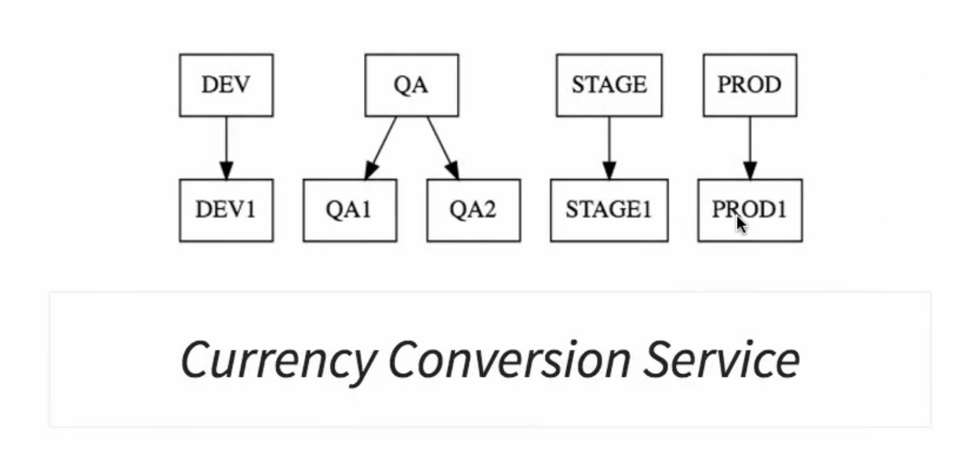
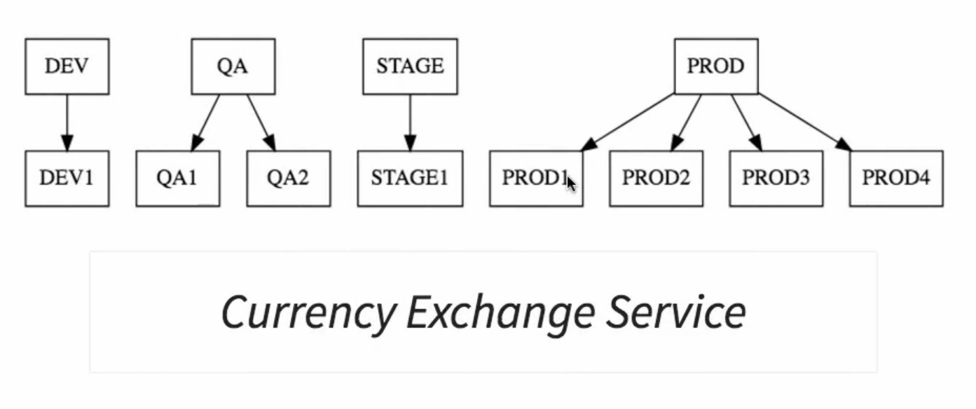
Setting up client side load balancing with Ribbon

Slide 47
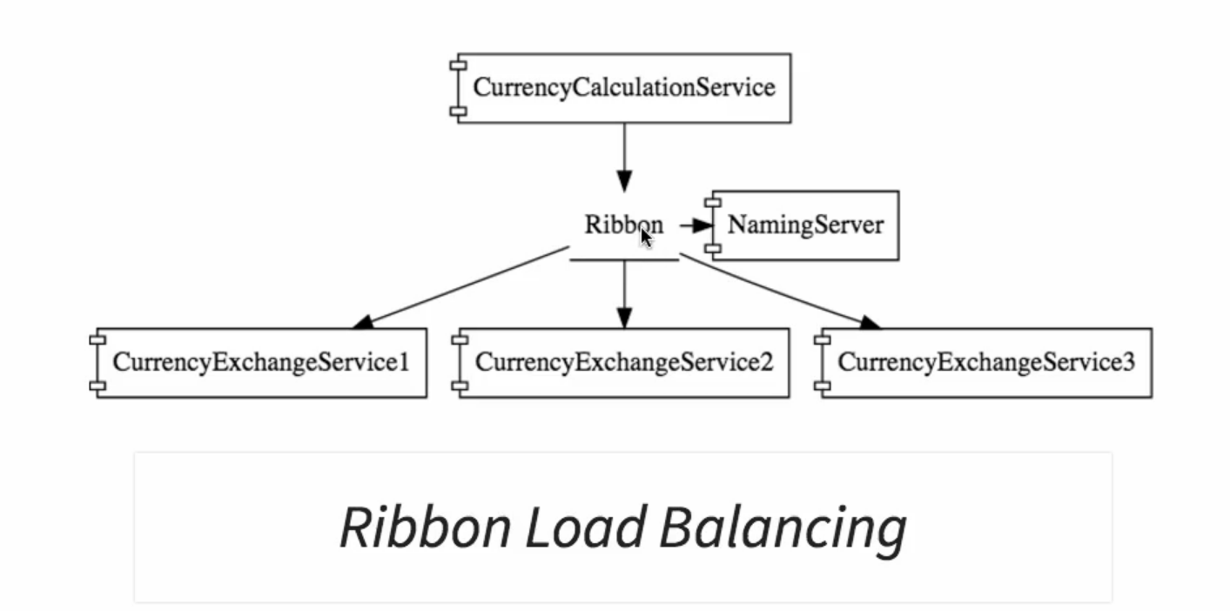
Setting up client side load balancing with Ribbon

Slide 48
Setting up client side load balancing with Ribbon
currency-conversion-service-12
<dependency>
<groupId>org.springframework.cloud</groupId>
<artifactId>spring-cloud-starter-netflix-ribbon</artifactId> </dependency>
Enable Ribbon on the proxy:
@RibbonClient(name="currency-exchange-service")

Slide 49
Setting up client side load balancing with Ribbon
// @FeignClient(name="currency-exchange-service", url="localhost:8000")
@FeignClient(name="currency-exchange-service")
=> Cause we will use more then one instance
Application.properties:
currency-exchange-service.ribbon.listOfServers=http://localhost:8000,http://localhost:8001
Test that ports are changing every call
http://localhost:8100/currency-converter-feign/from/USD/to/TND/quantity/100

Slide 50
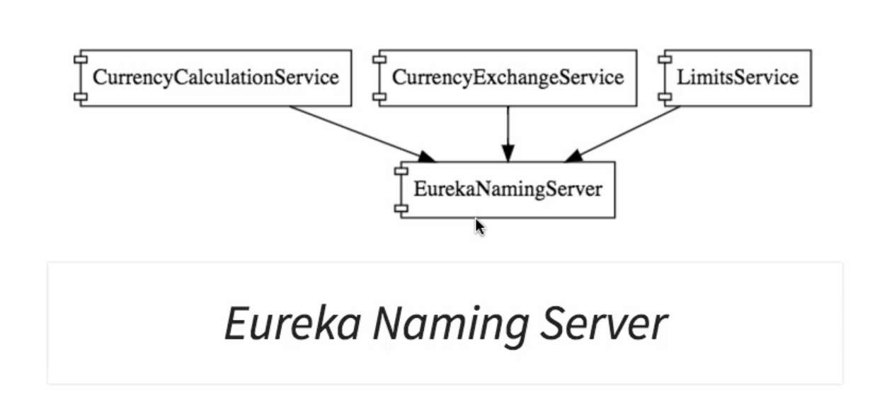
Understand the need for a Naming Server
currency-exchange-service.ribbon.listOfServers=http://localhost:8000,http://localhost:8001
=>

Slide 51
Setting up Eureka Naming Server
Create new microservice
netflix-eureka-naming-server-13
Dependecies:
Eureka Server
Config Client
Actuator
DevTools

Slide 52
Connecting Currency Conversion Microservices to Eureka
@EnableEurekaServer
spring.application.name=netflix-eureka-naming-server
server.port=8761
eureka.client.register-with-eureka=false
eureka.client.fetch-registry=false
Test:
http://localhost:8761/
Notes:
See how to specify sureka on other ip and port:
https://stackoverflow.com/questions/30850232/how-to-config-multiple-eureka-servers-from-client-in-spring-cloud
eureka.client.serviceUrl.defaultZone=http://localhost:8761/eureka/
eureka.client.serviceUrl.defaultZone=http://<peer1host>:<peer1port>/eureka,http://<peer2host>:<peer2port>/eureka

Slide 53
Connecting Currency Conversion Microservices to Eureka
currency-conversion-service-14
<dependency>
<groupId>org.springframework.cloud</groupId> <artifactId>spring-cloud-starter-netflix-eureka-client</artifactId> </dependency>
@EnableDiscoveryClient
#currency-exchange-service.ribbon.listOfServers=http://localhost:8000,http://localhost:8001
eureka.client.serviceUrl.defaultZone=http://localhost:8761/eureka/
eureka.client.serviceUrl.defaultZone=http://<peer1host>:<peer1port>/eureka,http://<peer2host>:<peer2port>/eureka
Notes:
See how to specify sureka on other ip and port:
https://stackoverflow.com/questions/30850232/how-to-config-multiple-eureka-servers-from-client-in-spring-cloud

Slide 54
Connecting Currency Exchange Microservices to Eureka
currency-exchange-service-15
<dependency>
<groupId>org.springframework.cloud</groupId> <artifactId>spring-cloud-starter-netflix-eureka-client</artifactId> </dependency>
@EnableDiscoveryClient eureka.client.serviceUrl.defaultZone=http://localhost:8761/eureka/
eureka.client.serviceUrl.defaultZone=http://<peer1host>:<peer1port>/eureka,http://<peer2host>:<peer2port>/eureka
Notes:
See how to specify sureka on other ip and port:
https://stackoverflow.com/questions/30850232/how-to-config-multiple-eureka-servers-from-client-in-spring-cloud

Slide 55
Distributing calls using Eureka and Ribbon
currency-conversion-service-16
#currency-exchange-service.ribbon.listOfServers=http://localhost:8000,http://localhost:8001
Test that ports are changing every call
http://localhost:8100/currency-converter-feign/from/USD/to/TND/quantity/100

Slide 56
Introduction to API Gateways

Slide 57
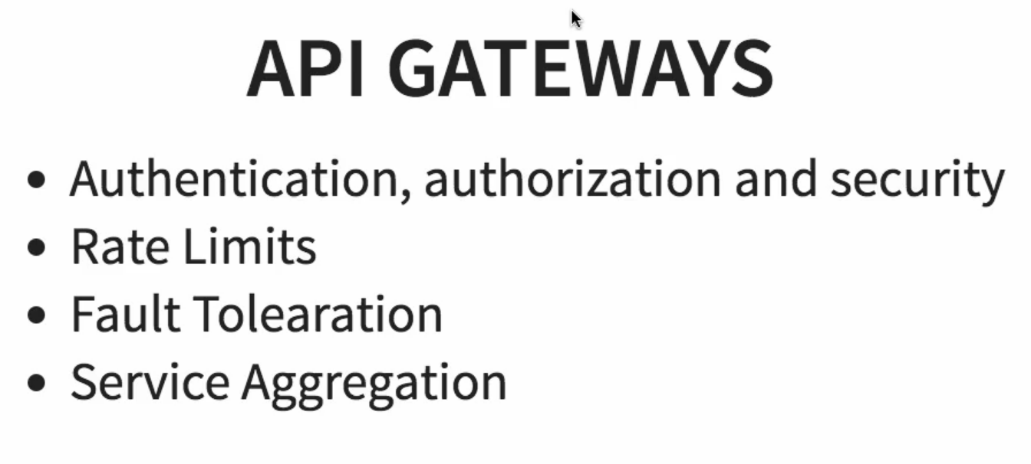
Introduction to API Gateways
Notes:
Fault toleration: Some services are not up, I should be able to give some defautl response back
Service aggregation: Instead of giving to a consumer 15 microservices, give him just one interface / one micro service /one api gateway to consume

Slide 58
Setting up Zuul API Gateway (1)
netflix-zuul-api-gateway-server-16
Dependencies:
Zuul
Eureka Discovery
DevTools
Actuator
@EnableZuulProxy
@EnableDiscoveryClient

Slide 59
Setting up Zuul API Gateway (2)
spring.application.name=netflix-zuul-api-gateway-server
server.port=8765
eureka.client.service-url.default-zone=http://localhost:8761/eureka

Slide 60
Implementing Zuul Logging Filter
netflix-zuul-api-gateway-server-17
ZuulLoggingFilter

Slide 61
Executing a request through Zuul API Gateway (1)
Be sure to have those running:
Eureka
Exchange service
Conversion service
Run Zuul
Be sure that all of them are displayed on Eureka: http://localhost:8761/

Slide 62
Executing a request through Zuul API Gateway (2)
Will request: http://localhost:8000/currency-exchange/from/EUR/to/TND Through http://localhost:8765/{application-name}/{uri}
=> http://localhost:8765/currency-exchange-service/currency-exchange/from/EUR/to/TND
Test it + Verify that the request is logged

Slide 63
Executing a request through Zuul API Gateway (3)
2019-05-21 17:27:00.084 INFO 2860 --- [nio-8765-exec-5] c.h.j.d.ZuulLoggingFilter : request -> org.springframework.cloud.netflix.zuul.filters.pre.Servlet30RequestWrapper@70b647f6 request uri -> /currency-exchange-service/currency-exchange/from/EUR/to/TND

Slide 64
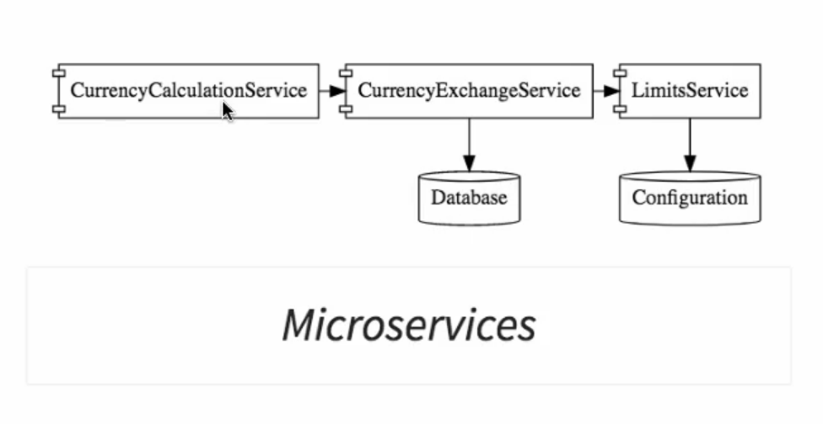
Setting up Zuul API Gateway between Microservices invocations (1)
Setting Zuul between conversion and exchange services

Slide 65
Setting up Zuul API Gateway between Microservices invocations (2)
In project currency-conversion-service-16
In CurrencyExchangeServiceProxy.java
// @FeignClient(name="currency-exchange-service")
@FeignClient(name="netflix-zuul-api-gateway-server")
// @GetMapping("/currency-exchange/from/{from}/to/{to}")
@GetMapping("currency-exchange-service/currency-exchange/from/{from}/to/{to}")

Slide 66
Setting up Zuul API Gateway between Microservices invocations (3)
Request:
http://localhost:8100/currency-converter-feign/from/USD/to/TND/quantity/100
=>
2019-05-21 17:37:13.867 INFO 2860 --- [nio-8765-exec-8] c.h.j.d.ZuulLoggingFilter : request -> org.springframework.cloud.netflix.zuul.filters.pre.Servlet30RequestWrapper@56801d10 request uri -> /currency-exchange-service/currency-exchange/from/USD/to/TND

Slide 67
Setting up Zuul API Gateway between Microservices invocations (4)
Now I want to pass also requests before conversion service through Zuul

Slide 68
Setting up Zuul API Gateway between Microservices invocations (5)
Will request: http://localhost:8765/{application-name}/{uri}
=> http://localhost:8765/currency-conversion-service/currency-converter-feign/from/USD/to/TND/quantity/100
You will see 2 loggings through Zuul Filter

Slide 69
Setting up Zuul API Gateway between Microservices invocations (6)
2019-05-21 17:48:45.574 INFO 2860 --- [nio-8765-exec-1] c.h.j.d.ZuulLoggingFilter : request -> org.springframework.cloud.netflix.zuul.filters.pre.Servlet30RequestWrapper@4f0ec6e6 request uri -> /currency-conversion-service/currency-converter-feign/from/USD/to/TND/quantity/100
2019-05-21 17:48:45.646 INFO 2860 --- [nio-8765-exec-2] c.h.j.d.ZuulLoggingFilter : request -> org.springframework.cloud.netflix.zuul.filters.pre.Servlet30RequestWrapper@4a5b833a request uri -> /currency-exchange-service/currency-exchange/from/USD/to/TND

Slide 70
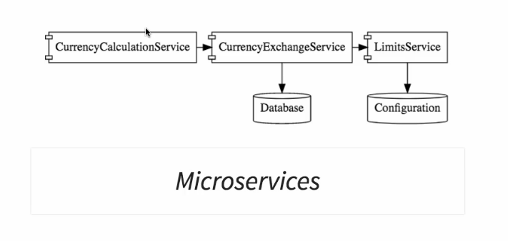
Introduction to Distributed Tracing
Spring Cloud Sleuth + Zipkin
Assign an id for each request
Zipkin: distributed tracing system
Traces will be collected in RabbitMQ
Then sent to Zipkin

Slide 71
Implementing Spring Cloud Sleuth (1)
We will choose to add Spring Cloud Sleuth to:
Convervsion service
Exchange service
Zuul (api gateway)
netflix-zuul-api-gateway-server-18

Slide 72
Implementing Spring Cloud Sleuth (2)
<dependency>
<groupId>org.springframework.cloud</groupId> <artifactId>spring-cloud-starter-sleuth</artifactId>
</dependency>
@Bean
public Sampler defaultSampler(){
return Sampler.ALWAYS_SAMPLE;
}

Slide 73
Implementing Spring Cloud Sleuth (3)
Do the same with conversion and exchange services
=> currency-conversion-service-19
=> currency-exchange-service-20
Add in both controllers of conversion and exchange
private Logger logger = LoggerFactory.getLogger(this.getClass());
logger.info("{}", exchangeValue);

Slide 74
Implementing Spring Cloud Sleuth (4)
You will see that Sleuth added an id to each request, so it can be tracked in all microservices.
Clear all Eclipse consoles, and then call:
http://localhost:8765/currency-conversion-service/currency-converter-feign/from/USD/to/TND/quantity/100
See above that for our request, all traces in exchange, conversion and Zuul have the same id.

Slide 75
Implementing Spring Cloud Sleuth (5)
2019-05-22 12:35:59.854 INFO [currency-exchange-service,2f01d6b6e7c415d1,198d7283a8816831,true] 16412 --- [nio-8000-exec-2] c.h.j.c.CurrencyExchangeController : com.hc.jee.currencyexchangeservice.ExchangeValue@48b5913b
2019-05-22 12:35:59.859 INFO [currency-conversion-service,2f01d6b6e7c415d1,ea05c5bbc6c70a21,true] 18068 --- [nio-8100-exec-3] c.h.j.c.CurrencyConversionController : com.hc.jee.currencyconversionservice.CurrencyConversionBean@5fb93cf1

Slide 76
Implementing Spring Cloud Sleuth (6)
2019-05-22 12:35:59.826 INFO [netflix-zuul-api-gateway-server,2f01d6b6e7c415d1,2f01d6b6e7c415d1,true] 3316 --- [nio-8765-exec-5] c.h.j.d.ZuulLoggingFilter : request -> org.springframework.cloud.netflix.zuul.filters.pre.Servlet30RequestWrapper@4c6687c8 request uri -> /currency-conversion-service/currency-converter-feign/from/USD/to/TND/quantity/100
2019-05-22 12:35:59.841 INFO [netflix-zuul-api-gateway-server,2f01d6b6e7c415d1,2588d048d3201c7e,true] 3316 --- [nio-8765-exec-6] c.h.j.d.ZuulLoggingFilter : request -> org.springframework.cloud.netflix.zuul.filters.pre.Servlet30RequestWrapper@76523af1 request uri -> /currency-exchange-service/currency-exchange/from/USD/to/TND

Slide 77
Implementing Spring Cloud Sleuth (7)
Now we need to collect them in one place.

Slide 78
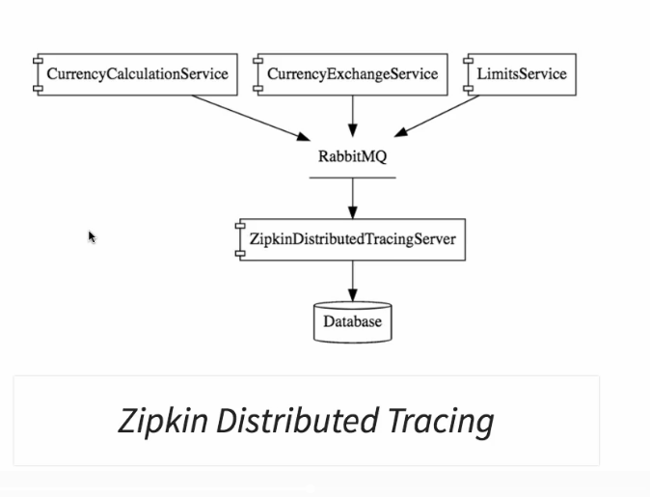
Introduction to Distributed Tracing with Zipkin

Slide 79
Installing Rabbit MQ
First, download & install Erlang:
http://www.erlang.org/downloads
Download and Install RabbitMQ:
https://www.rabbitmq.com/install-windows.html
#to enable web console of rabbitmq
Under C:\Program Files\RabbitMQ Server\rabbitmq_server-3.7.15\sbin:
rabbitmq-plugins enable rabbitmq_management
http://127.0.0.1:15672/
guest/guest

Slide 80
Installing Zipkin
Download Zipkin from here:
https://search.maven.org/remote_content?g=io.zipkin.java&a=zipkin-server&v=LATEST&c=exec
Launch it:
set RABBIT_URI=amqp://localhost:5672
java -jar zipkin-server-2.12.9-exec.jar
Test it (zipkin server) here: http://localhost:9411/

Slide 81
Connecting Microservices to Zipkin
Add below depencies (in next slide) to:
Exchange service (currency-exchange-service-21)
Conversion service (currency-conversion-service-22)
Zuul (netflix-zuul-api-gateway-server-23)

Slide 82
Setting up Distributed Tracing with Zipkin
<dependency>
<groupId>org.springframework.cloud</groupId>
<artifactId>spring-cloud-sleuth-zipkin</artifactId>
</dependency>
<dependency>
<groupId>org.springframework.cloud</groupId>
<artifactId>spring-cloud-starter-bus-amqp</artifactId>
</dependency>

Slide 83
Using Zipkin UI Dashboard to trace requests
Restart all in this order:
1- naming server
2- zipkin
3- zuul
4- microservices: exchange then conversion
Trace the full request here: http://localhost:9411/

Slide 84
Understanding the need for Spring Cloud Bus
Create a duplicated instance of limits service and run it on 8081
In bootstrap.properties:
management.endpoints.web.exposure.include=*
limits-service-24
See values with: http://localhost:8080/limits
In spring cloud config server to, add new folder and link it to git-localconfig-repo
Change value to limits-service.minimum=11 + git add –A + git commit
Call again limits service localhost:8081/limits ➔ nothing will be updated

Slide 85
Understanding the need for Spring Cloud Bus (2)
Via postmain, send a POST request to:
http://localhost:8080/actuator/refresh
Now check again: http://localhost:8080/limits
=> Values are updated
Check the other instance running on 8081: http://localhost:8081/limits
Instance is not updated

Slide 86
Implementing Spring Cloud Bus
If we have 500 instance of this microservice, updating the config will be a pain
You should have rabbitMQ up and running
limits-service-25
Notes:
management.security.enabled=false

Slide 87
Implementing Spring Cloud Bus
Add Cloud Bus Dependency + rabbitmq to limits service:
<dependency>
<groupId>org.springframework.cloud</groupId>
<artifactId>spring-cloud-bus</artifactId>
</dependency>
<dependency>
<groupId>org.springframework.cloud</groupId>
<artifactId>spring-cloud-starter-bus-amqp</artifactId>
</dependency>

Slide 88
Implementing Spring Cloud Bus
Start the 2 limits instances
Make change in config
Make one POST: http://localhost:8080/actuator/bus-refresh
!!!!! /actuator/bus-refresh and not /actuator/refresh like in previous case !!!!!
See that both have been changed

Slide 89
Fault Tolerance with Hystrix
limits-service-26
Add Hystrix (Cloud Circuit Breaker) dependency
<dependency>
<groupId>org.springframework.cloud</groupId>
<artifactId>spring-cloud-starter-netflix-hystrix</artifactId>
</dependency>
@EnableHystrix

Slide 90
Fault Tolerance with Hystrix (2)
In limit microservice controller:
@GetMapping("/fault-tolerance-example")
@HystrixCommand(fallbackMethod = "fallbackRetrieveConfiguration")
public LimitConfiguration retrieveConfiguration() {
throw new RuntimeException();
}
public LimitConfiguration fallbackRetrieveConfiguration() {
return new LimitConfiguration(9, 999);
}

Slide 91
Fault Tolerance with Hystrix (3)
Test it with:
http://localhost:8080/fault-tolerance-example

Slide 92
WebClient vs RestTemplate
Webclient: Asynchronous call
RestTemplate: Synchronous call
We trend to asynchronous call rather then synchronous call
Notes:
RestTemplate is synchronous and blocking
WebClient is complete opposite of this

Slide 93
WebClient vs RestTemplate
currency-conversion-service-27
Adding Reactive Web dependency:
<dependency> <groupId>org.springframework.boot</groupId> <artifactId>spring-boot-starter-webflux</artifactId> </dependency>
Notes:
RestTemplate is synchronous and blocking
WebClient is complete opposite of this

Slide 94
WebClient vs RestTemplate
See new code.
Test it using:
http://localhost:8100/currency-converter-nextlevel/from/USD/to/TND/quantity/100

Slide 95
Docker

Slide 96
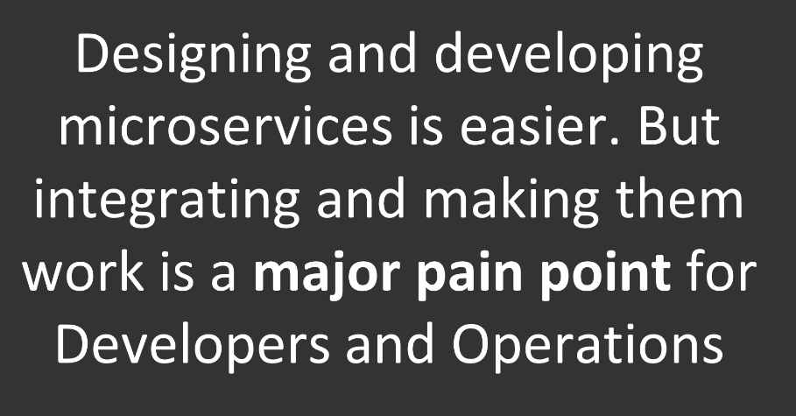
Why Docker for microservices?

Slide 97
What Is Docker

Slide 98
What Is Docker

Slide 99
VMs vs Containers

Slide 100
What Is Docker

Slide 101
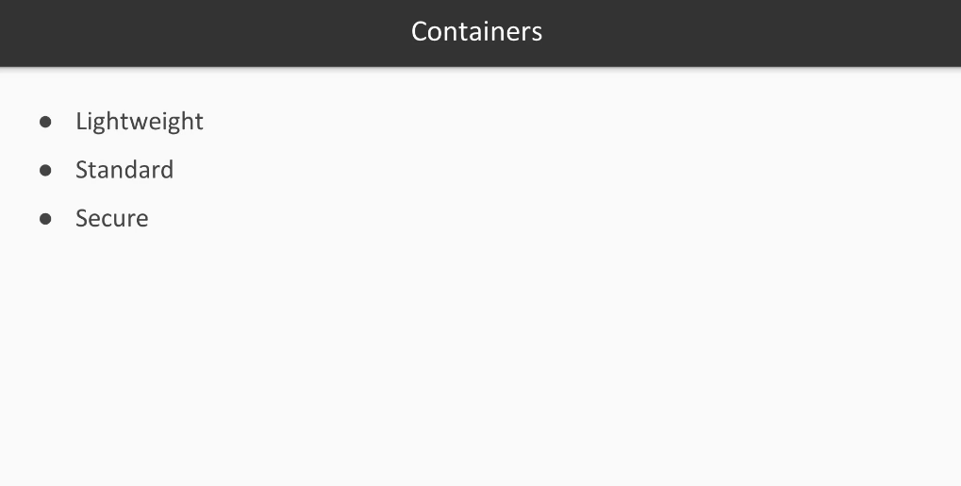

Slide 102
What Is Docker

Slide 103
What Is Docker

Slide 104
What Is Docker
Notes:
Agility: by faster creating containers and running them

Slide 105
What Is Docker
Notes:
Agility: by faster creating containers and running them

Slide 106
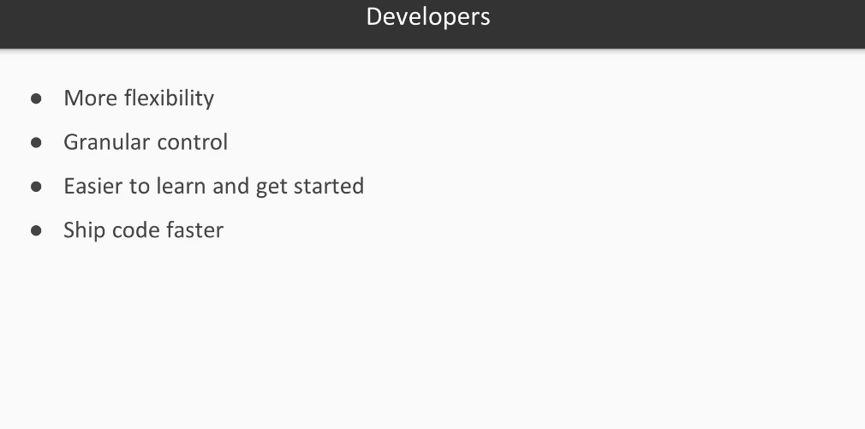
What Is Docker
Notes:
Agility: by faster creating containers and running them

Slide 107
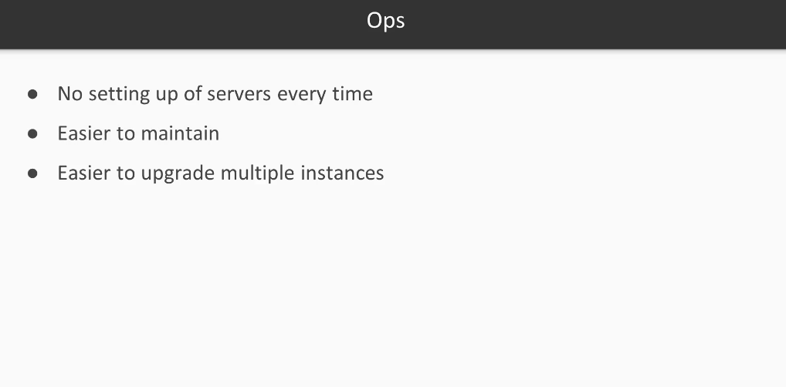
What Is Docker
Notes:
Agility: by faster creating containers and running them

Slide 108
Generating Microservices

Slide 109
What is JHipster
JHipster = Java Hipster
https://www.jhipster.tech/

Slide 110
Architecture of Jhipster microservices
https://www.jhipster.tech/microservices-architecture/

Slide 111
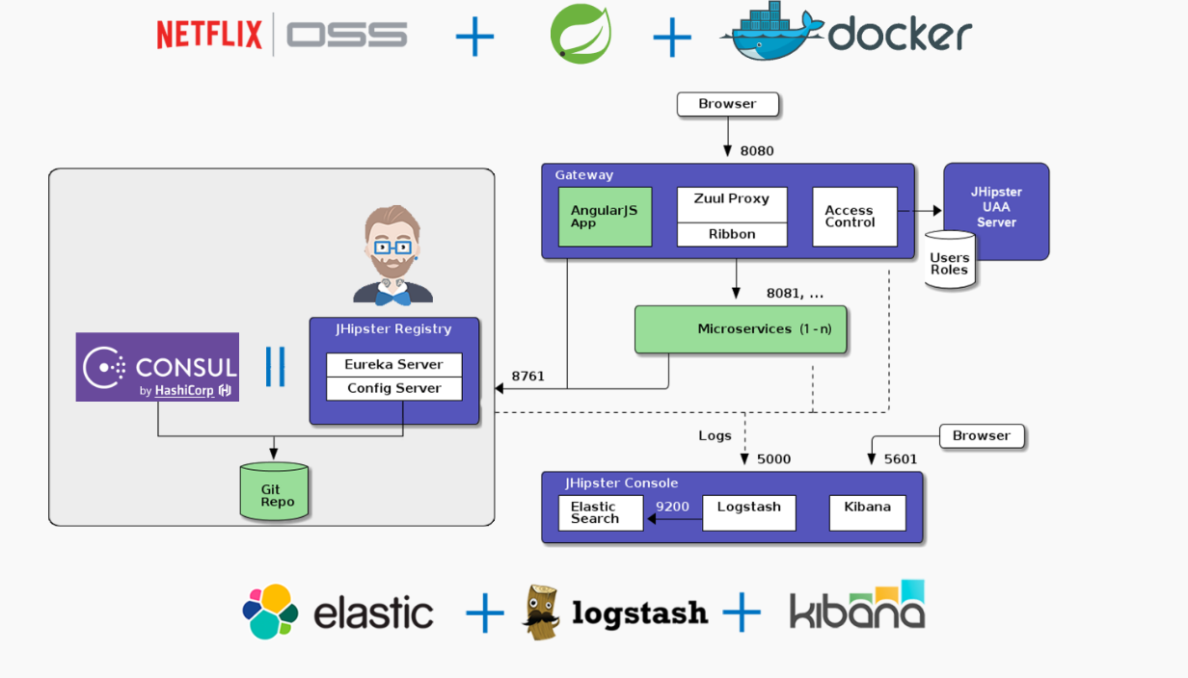
Architecture of Jhipster microservices
https://www.jhipster.tech/microservices-architecture/

Slide 112
Create JHipster application
https://start.jhipster.tech/#/
Register
Login
Click on Create application menu
Application name: day36storeapp01
Application type: microservice gateway
Frong End: Angular
Download as zip file

Slide 113
Create one microservice application
https://start.jhipster.tech/#/
Login
Click on Create application menu
Application name: day36invoiceapp01
Application type: microservice application
(No Front End option is shown)
Download as zip file

Slide 114
Create one microservice application
Extract the 2 zip packages
Open cmd console in day36storeapp01
We will install npm dependencies using yarn. So we need to install yarn first.
Download & Install yarn: https://yarnpkg.com/en/docs/install#windows-stable
Open cmd in day36storeapp01
Type: yarn
It will take a long time for installation
Type: yarn start
Notes:
NPM vs Yarn: the Difference
Yarn has a few differences from npm. First of all, Yarn caches all installed packages. Yarn is installing the packages simultaneously, and that is why Yarn is faster than NPM. They both download packages from npm repository. Yarn generates yarn.lock to lock down the versions of package’s dependencies by default. On the contrary, npm for this purpose offers shrinkwrap CLI command.

Slide 115
Create one microservice application
docker-compose -f src/main/docker/jhipster-registry.yml up -d
./mvnw (for both projects)
See Front End at:
http://91.134.253.48:8080/
Jhispter registry:
http://91.134.253.48:8761/
Notes:
http://91.134.253.48:9000/

Slide 116
Terminologies in Docker

Slide 117
Terminologies in Docker

Slide 118
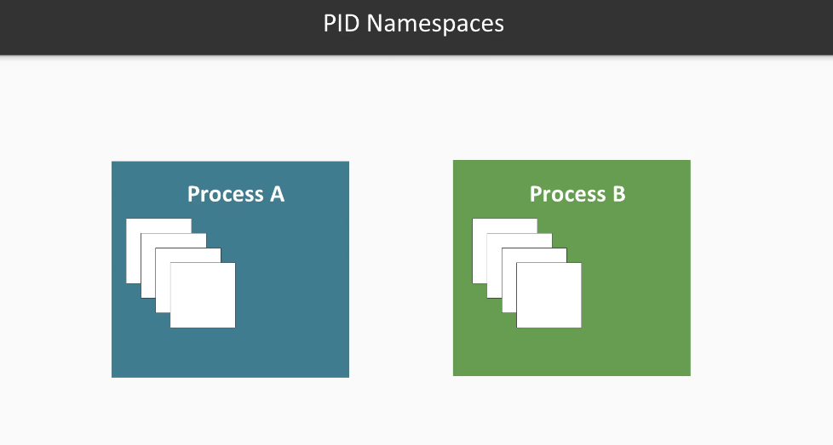
Terminologies in Docker

Slide 119
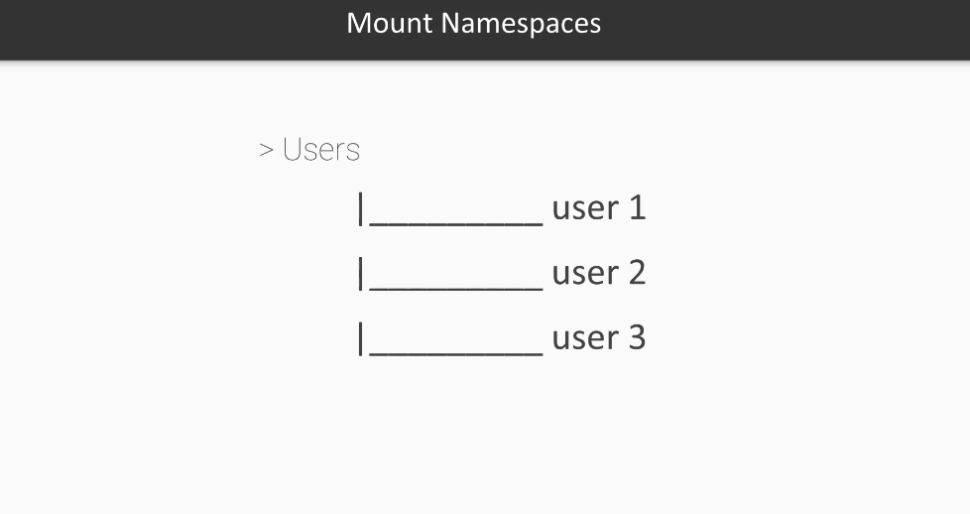
Terminologies in Docker

Slide 120
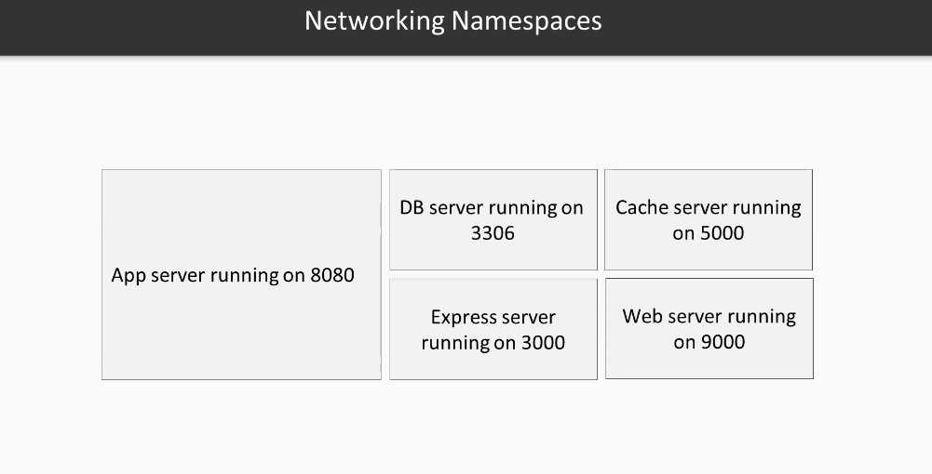
Terminologies in Docker

Slide 121
Terminologies in Docker

Slide 122
Terminologies in Docker

Slide 123
Terminologies in Docker

Slide 124
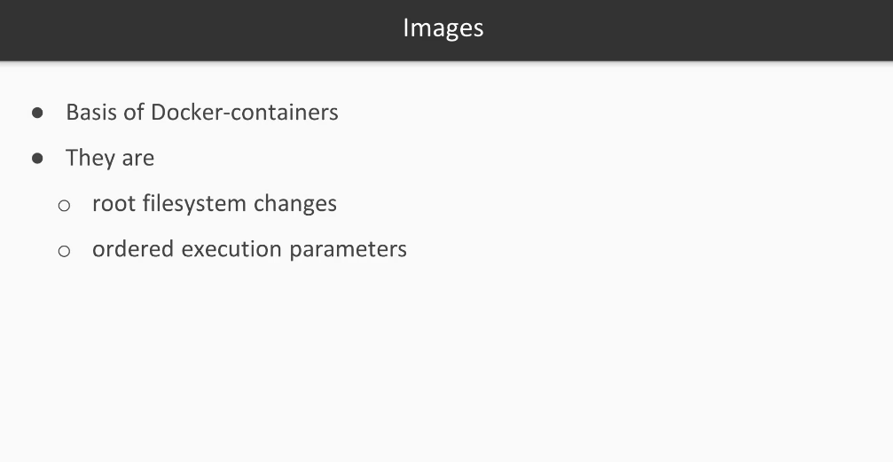
Terminologies in Docker

Slide 125
Terminologies in Docker

Slide 126
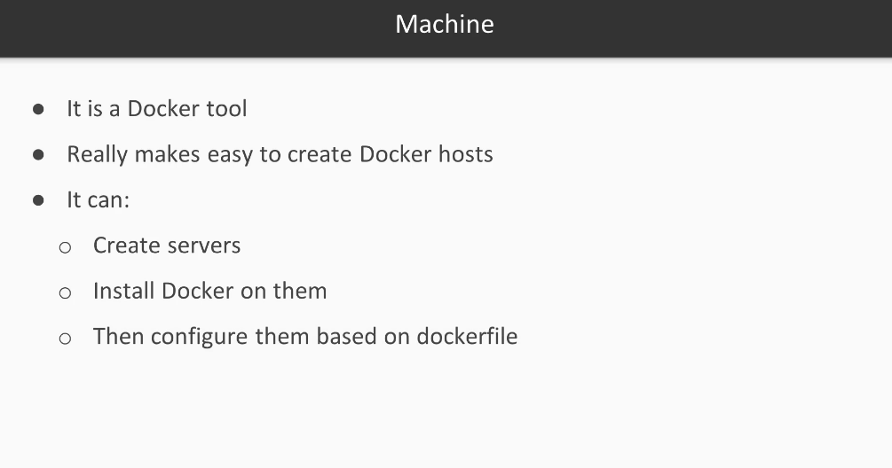
Terminologies in Docker

Slide 127
Terminologies in Docker

Slide 128
Terminologies in Docker

Slide 129
Terminologies in Docker

Slide 130
Terminologies in Docker

Slide 131
Getting Started with Docker

Slide 132
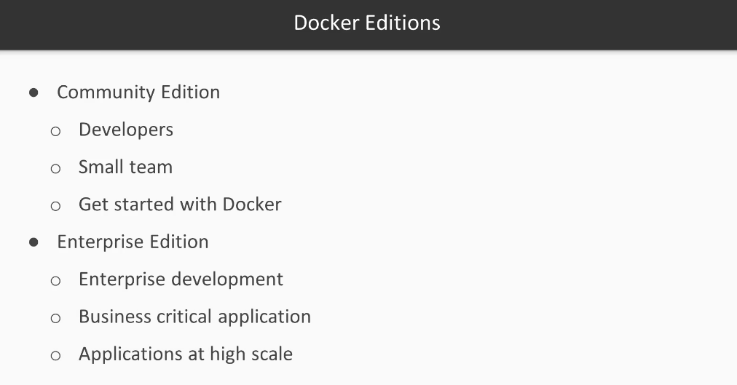
Getting Started with Docker

Slide 133
Install Docker
https://www.docker.com/
Download and install docker for windows:
https://docs.docker.com/docker-for-windows/install/

Slide 134
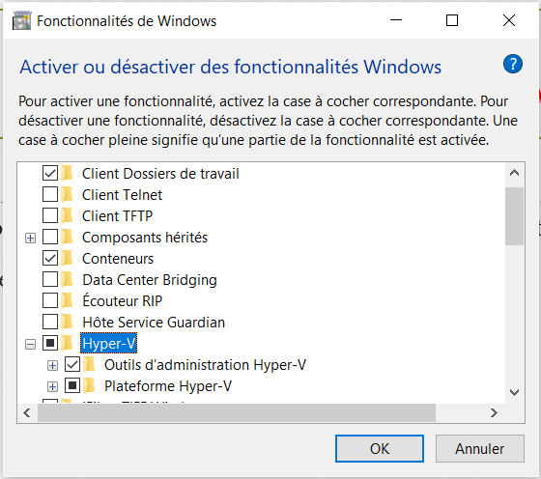
Enable HyperV
Open the menu: « Activer ou désactiver
des fonctionnalités Windows »
Select Hyper-V

Slide 135
Running Your First Container

Slide 136
docker run
> docker run hello-world
See output
> docker run -it ubuntu bash
Enter in ubuntu container and execute bash command
> ls
> exit

Slide 137
docker image
> docker image --help
See possible options (ls, pull, push, rm, tag…)
> docker image ls

Slide 138
docker container
> docker container --help
See possible options (kill, logs, ls, pause, restar, rm, start, stop…)
> docker container ls
> docker container stop 4e968d06c83a
> docker container ls
> docker container start 4e968d06c83a
> docker container ls
> docker container logs 4e968d06c83a

Slide 139
Docker CLI Basics

Slide 140
Dockerfile

Slide 141
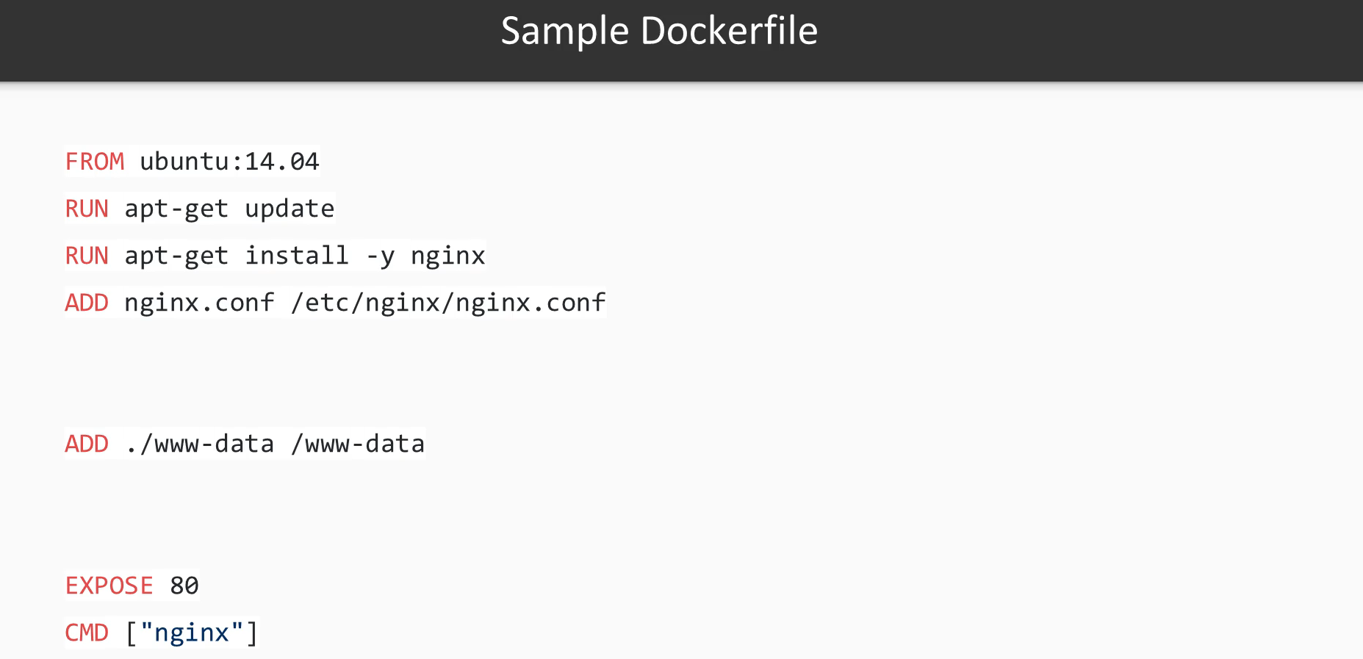
Dockerfile

Slide 142
Dockerfile: Create the Node.js app
https://nodejs.org/de/docs/guides/nodejs-docker-webapp/
After creating dockerfile:
Docker build –t berrais/node-web-app .

Slide 143
Setting Environment Variables for the Container
Add to our dockerfile of node image:
ENV foo «bar»
Run echo «bar »
Docker build .

Slide 144
Tagging the Containers
docker tag berrais/node-web-app berrais/node-web-app:v0.0.0

Slide 145
Checking the Logs of the Container
docker logs …. –until 2s

Slide 146
Docker Ports and Volumes
Docker run –p 127,0,0,1:8080:8080 berrais/node-web-app

Slide 147
Creating application file with docker compose

Slide 148
Docker Compose

Slide 149
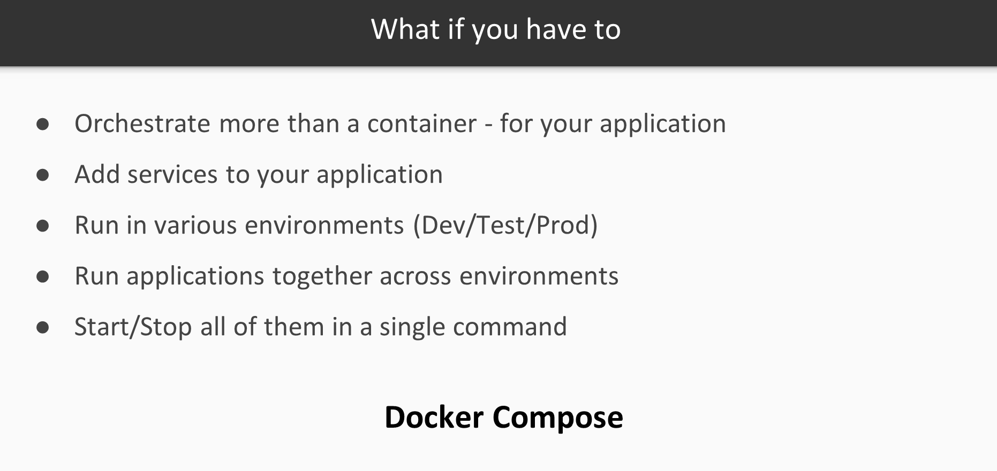

Slide 151
Vi /home/ayoub/2019/05/27/day36storeapp01/src/main/docker/app.yml

Slide 153
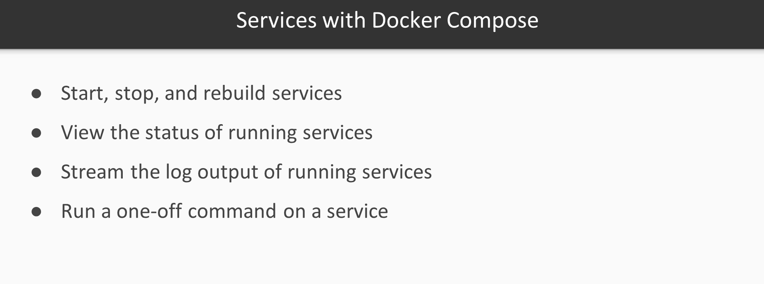

Slide 155
Creating Your Docker Compose

Slide 156
Starting and Stopping Using Docker Compose
Docker-compose –f file.yml up
Docker-compose –f file.yml up –d
Docker-compose –f file.yml down

Slide 157
Docker Registry

Slide 159
Docker Registry

Slide 160
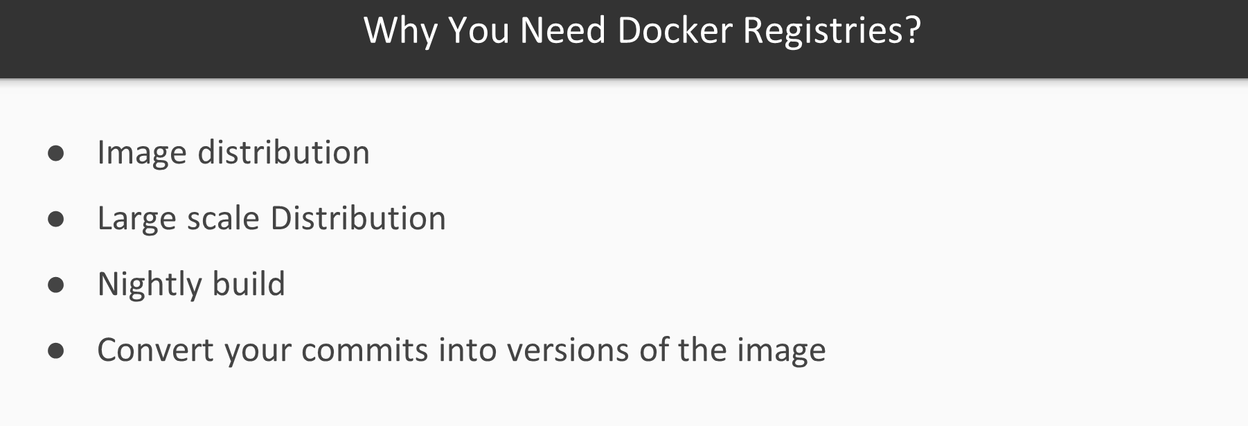
Docker Registry

Slide 161
Docker Registry
https://hub.docker.com/

Slide 162
Pushing and Pulling Images in Registry
Docker login
Docker image push …
Docker image pull …

Slide 163
Exercise

Slide 164
Ship your code in a dokcer container
Create a new HelloWorld SpringBoot application
Dockerize it
Push it in Docker Hub.

Slide 165
Dockerfile
FROM openjdk:8-jdk-alpine
VOLUME /tmp
ARG JAR_FILE
ADD ${JAR_FILE} app.jar
ENTRYPOINT ["java", "-jar", "/app.jar"]

Slide 166
pom.xml
<properties>
<java.version>1.8</java.version>
<docker.image.prefix>springio</docker.image.prefix>
</properties>
Add what is below (next slide) to: /project/build/plugins

Slide 167
pom.xml
<plugin>
<groupId>com.spotify</groupId>
<artifactId>dockerfile-maven-plugin</artifactId>
<version>1.4.9</version>
<configuration>
<repository>${docker.image.prefix}/${project.artifactId}</repository>
<buildArgs>
<JAR_FILE>target/${project.build.finalName}.jar</JAR_FILE>
</buildArgs>
</configuration>
</plugin>

Slide 168
Run it
mvn install dockerfile:build
docker run -p 91.134.253.48:8080:8080 springio/demo
docker run -p 8080:8080 springio/demo
Notes:
DALI: docker run -p 8080:8080 springio/limits-service
docker save -o limits-services.tar.gz springio/limits-service

Slide 169
Run it
Relaunch the docker image with dev profile
docker ps
docker stop 8ecb7229ee49
docker rm 8ecb7229ee49
docker ps
docker run -e "SPRING_PROFILES_ACTIVE=dev" -p 8080:8080 -t springio/demo
Check that in logs you have you see: The following profiles are active: dev
Notes:
sudo docker ps
sudo docker stop cd52607be05b
sudo docker rm cd52607be05b
sudo docker ps
sudo docker run -e "JAVA_OPTS=\"-agentlib:jdwp=transport=dt_socket,address=0.0.0.0:5005,server=y,suspend=n\"" -p 8080:8080 -p 5005:5005 -t springio/demo

Slide 170
Tagging image
sudo docker tag springio/demo springio/demo:latest
Notes:
sudo docker login --username=yourhubusernam
docker images docker tag bb38976d03cf yourhubusername/verse_gapminder:firsttry docker push yourhubusername/verse_gapminder
docker save verse_gapminder > verse_gapminder.tar docker load --input verse_gapminder.tar
https://ropenscilabs.github.io/r-docker-tutorial/04-Dockerhub.html

Slide 171
Generating Microservices

Slide 172
What is JHipster
JHipster = Java Hipster
https://www.jhipster.tech/

Slide 173
Architecture of Jhipster microservices
https://www.jhipster.tech/microservices-architecture/

Slide 174
Architecture of Jhipster microservices
https://www.jhipster.tech/microservices-architecture/

Slide 175
Create JHipster application
https://start.jhipster.tech/#/
Register
Login
Click on Create application menu
Application name: day36storeapp01
Application type: microservice gateway
Frong End: Angular
Download as zip file

Slide 176
Create one microservice application
https://start.jhipster.tech/#/
Login
Click on Create application menu
Application name: day36invoiceapp01
Application type: microservice application
(No Front End option is shown)
Download as zip file

Slide 177
Create one microservice application
Extract the 2 zip packages
Open cmd console in day36storeapp01
We will install npm dependencies using yarn. So we need to install yarn first.
Download & Install yarn: https://yarnpkg.com/en/docs/install#windows-stable
Open cmd in day36storeapp01
Type: yarn
It will take a long time for installation
Type: yarn start
Notes:
NPM vs Yarn: the Difference
Yarn has a few differences from npm. First of all, Yarn caches all installed packages. Yarn is installing the packages simultaneously, and that is why Yarn is faster than NPM. They both download packages from npm repository. Yarn generates yarn.lock to lock down the versions of package’s dependencies by default. On the contrary, npm for this purpose offers shrinkwrap CLI command.

Slide 178
Create one microservice application
docker-compose -f src/main/docker/jhipster-registry.yml up -d
./mvnw (for both projects)
See Front End at:
http://91.134.253.48:8080/
Jhispter registry:
http://91.134.253.48:8761/
Notes:
http://91.134.253.48:9000/

